Slide 1

NASA soldering

Slide 2


Slide 3
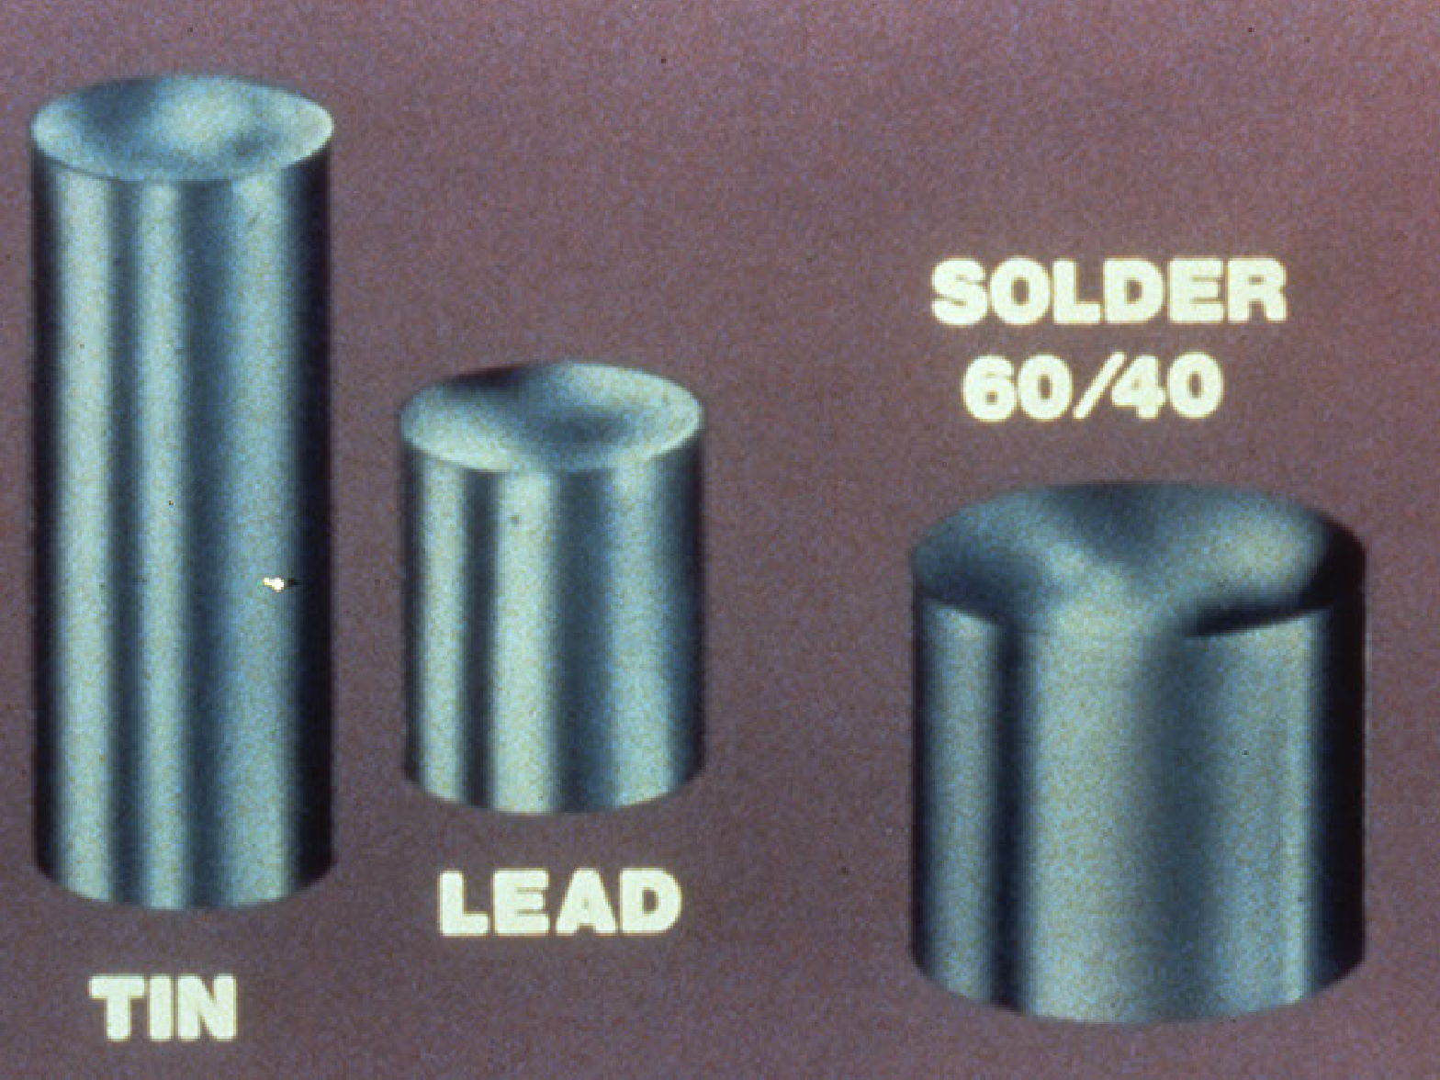
Tin and Lead = 60/40 solder

Slide 4
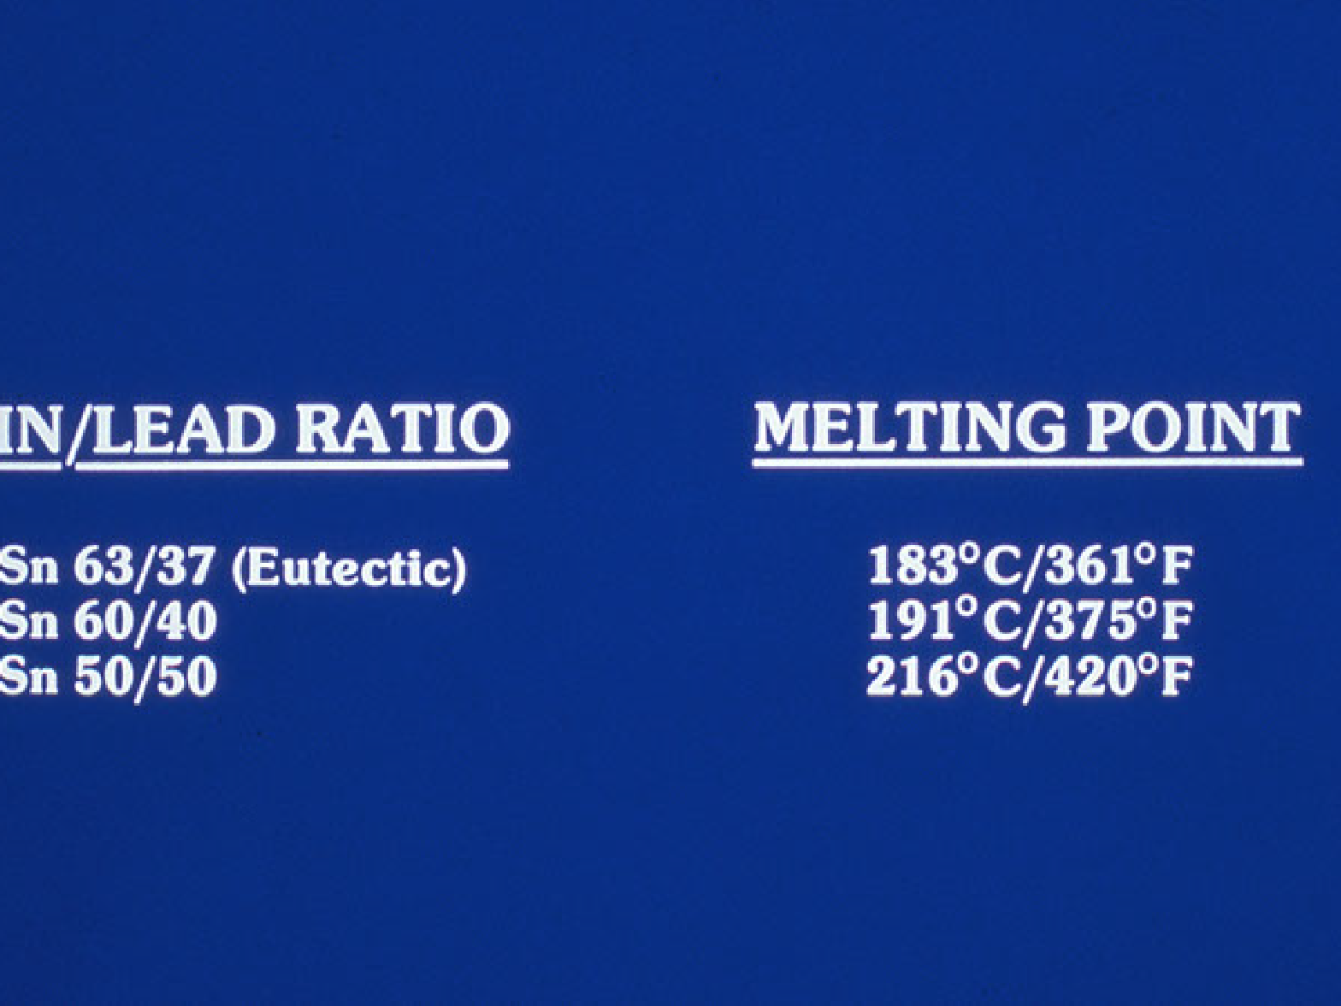
Tin/Lead ratio/melting point

Slide 5
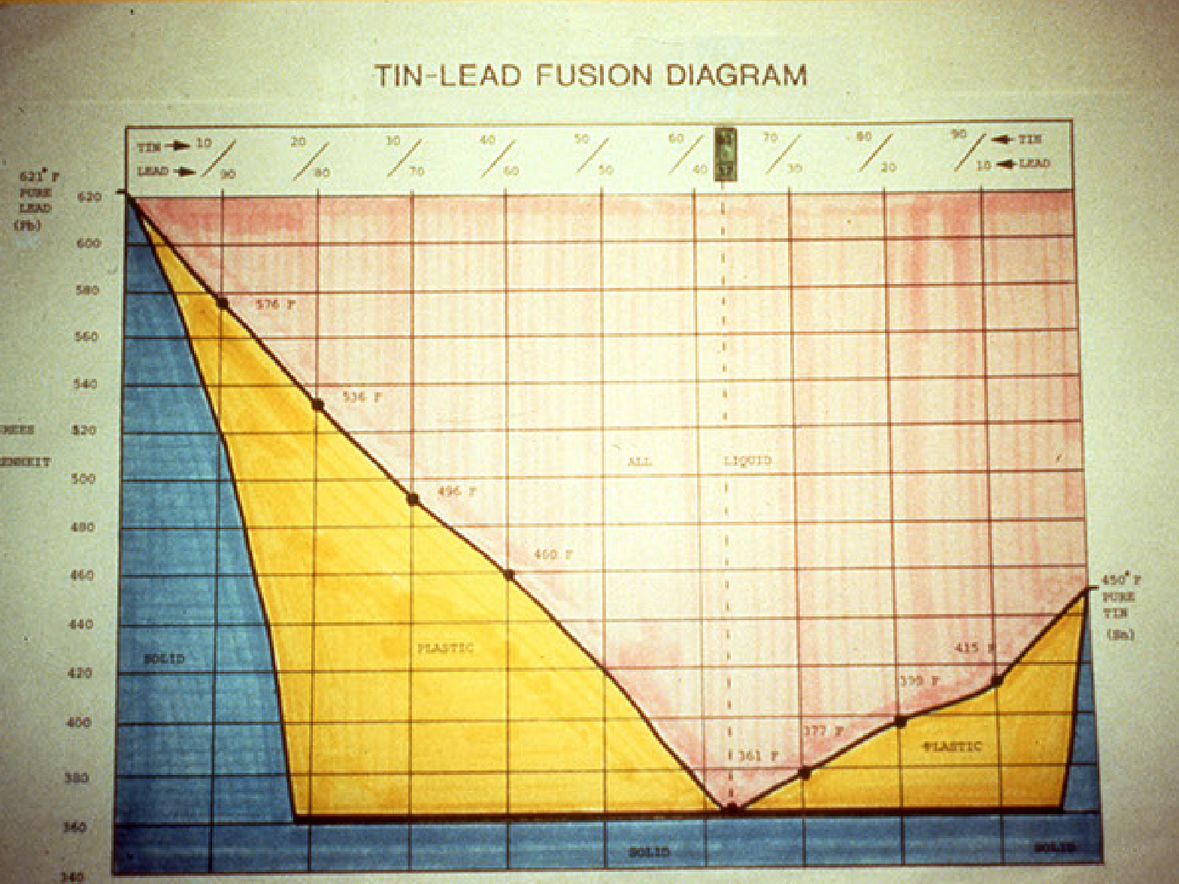
Tin/Lead Fusion

Slide 6
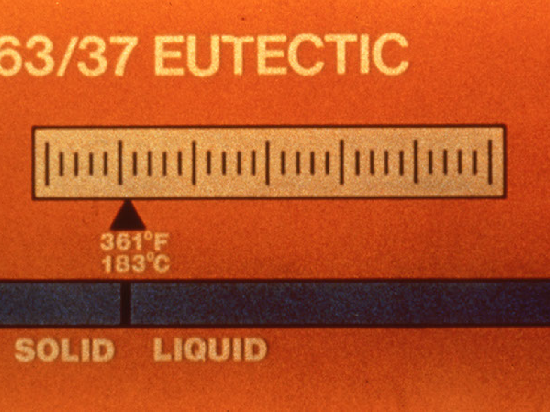
63/37 Eutectic solder liquid temperature

Slide 7
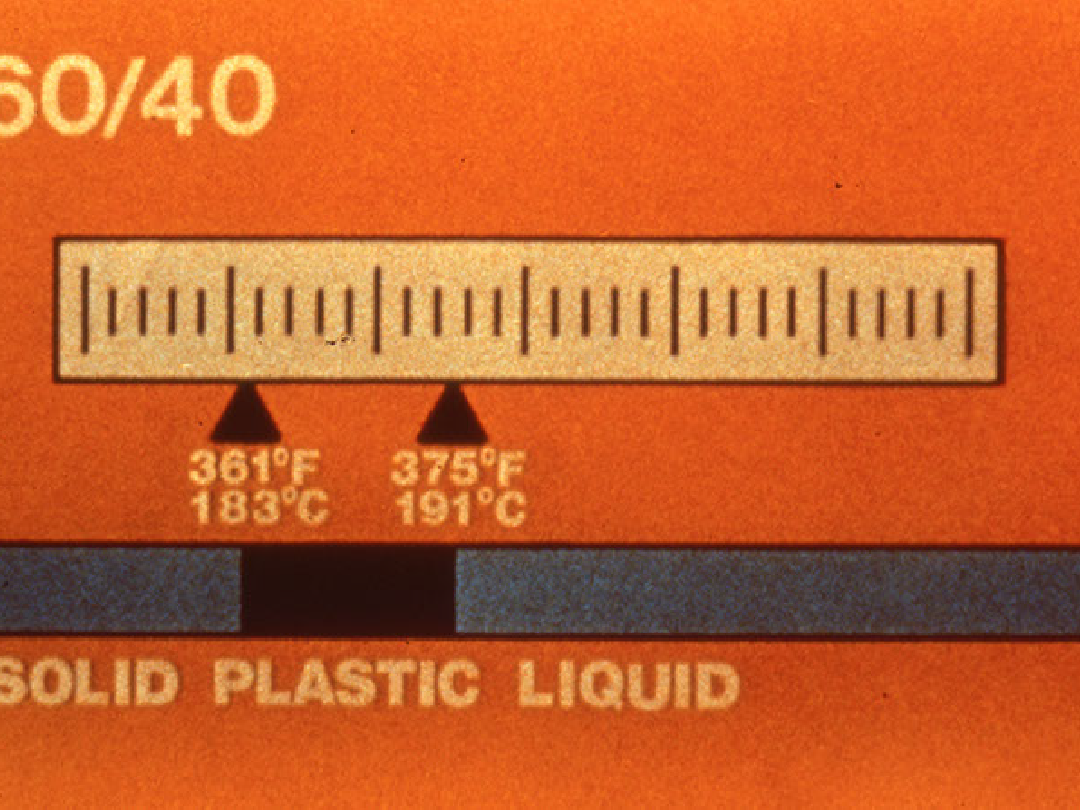
60/40 solder with solid/plastic/liquid temperatures

Slide 8
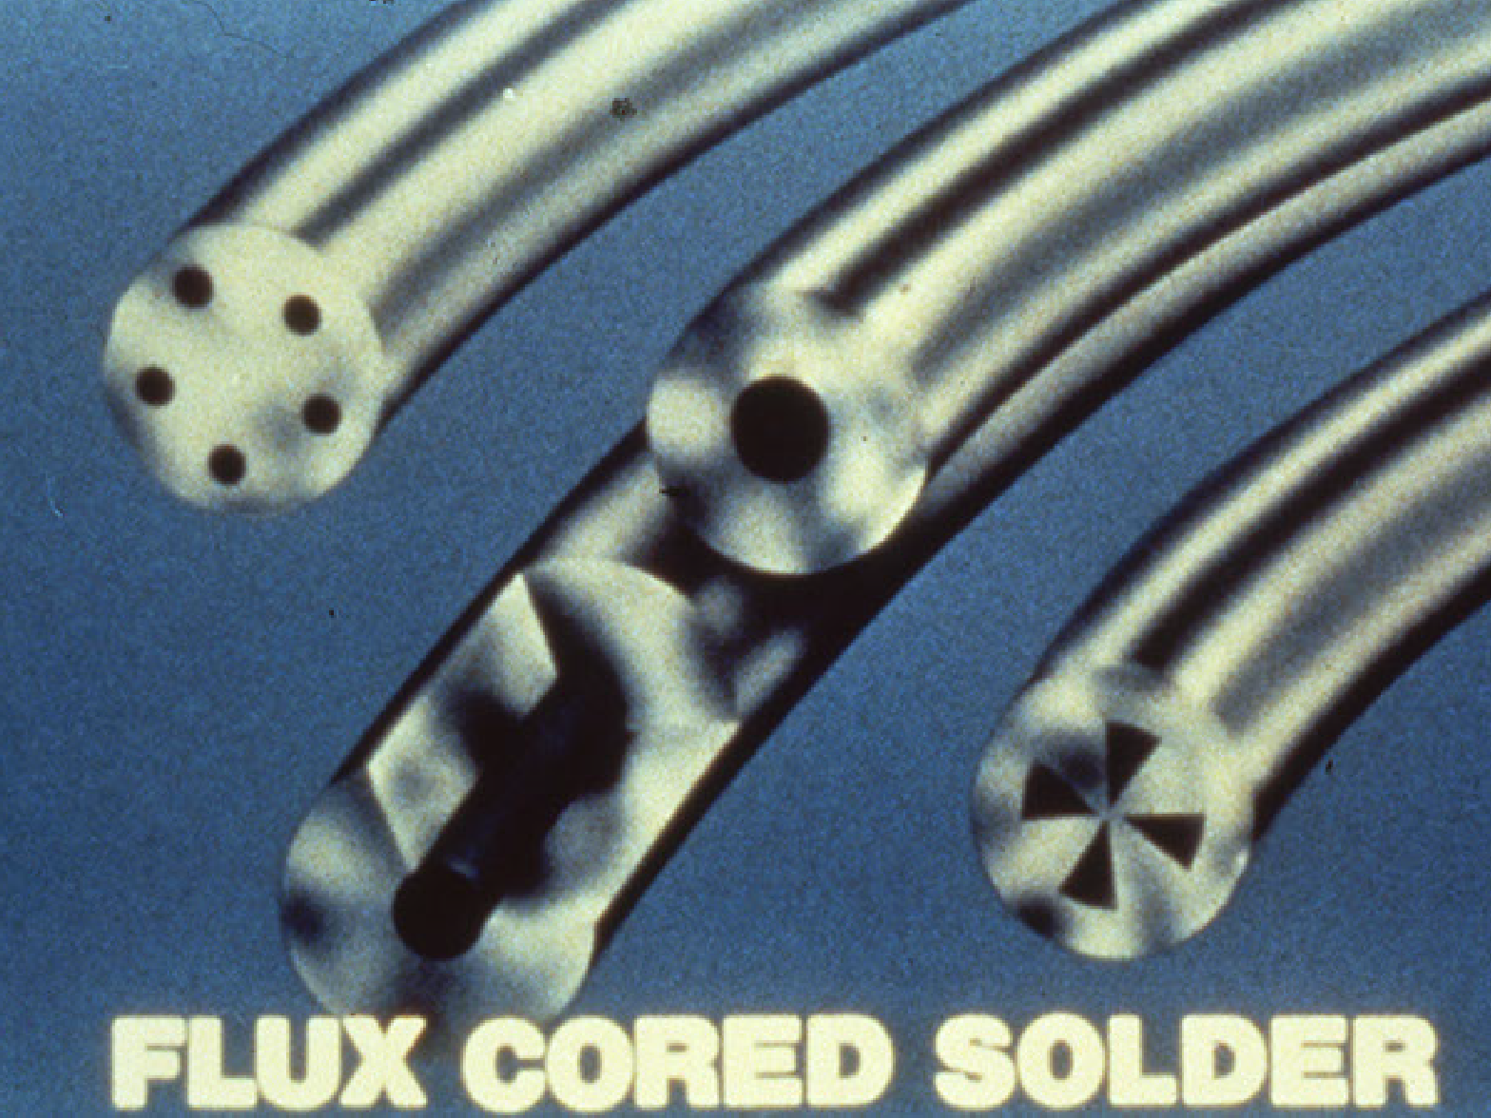

Slide 9
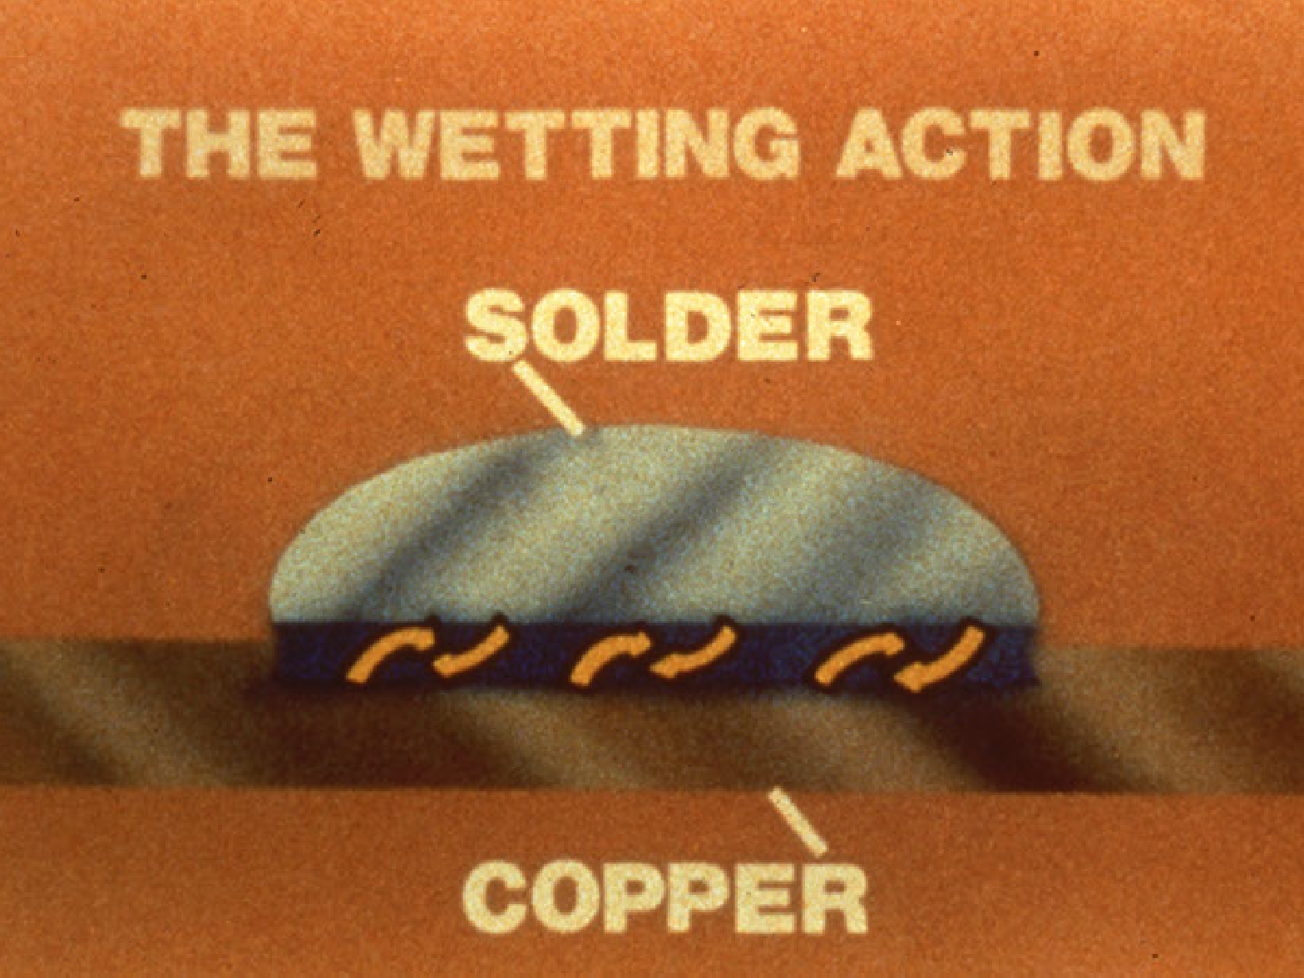

Slide 10
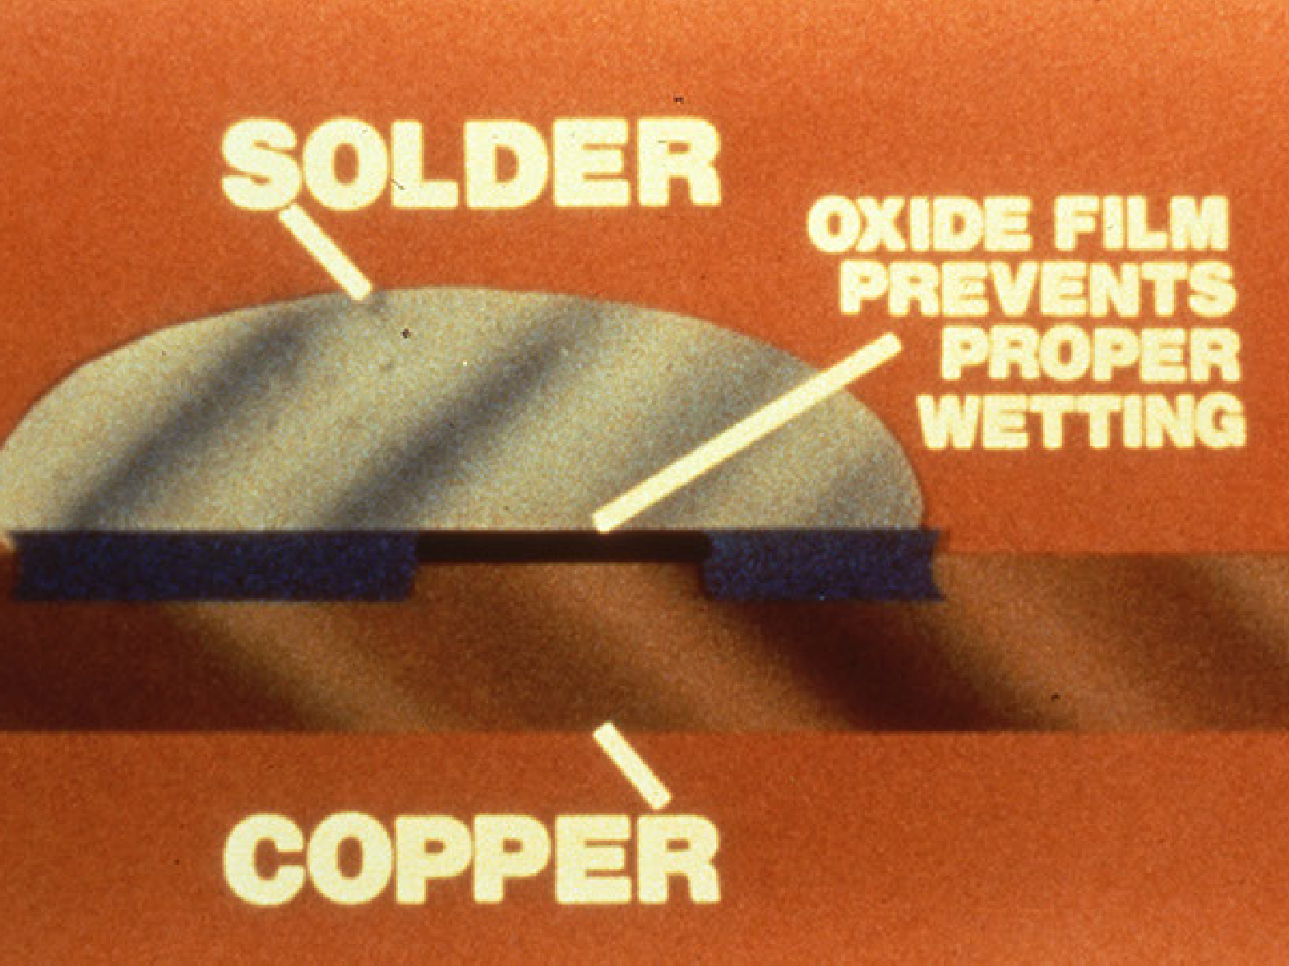

Slide 11
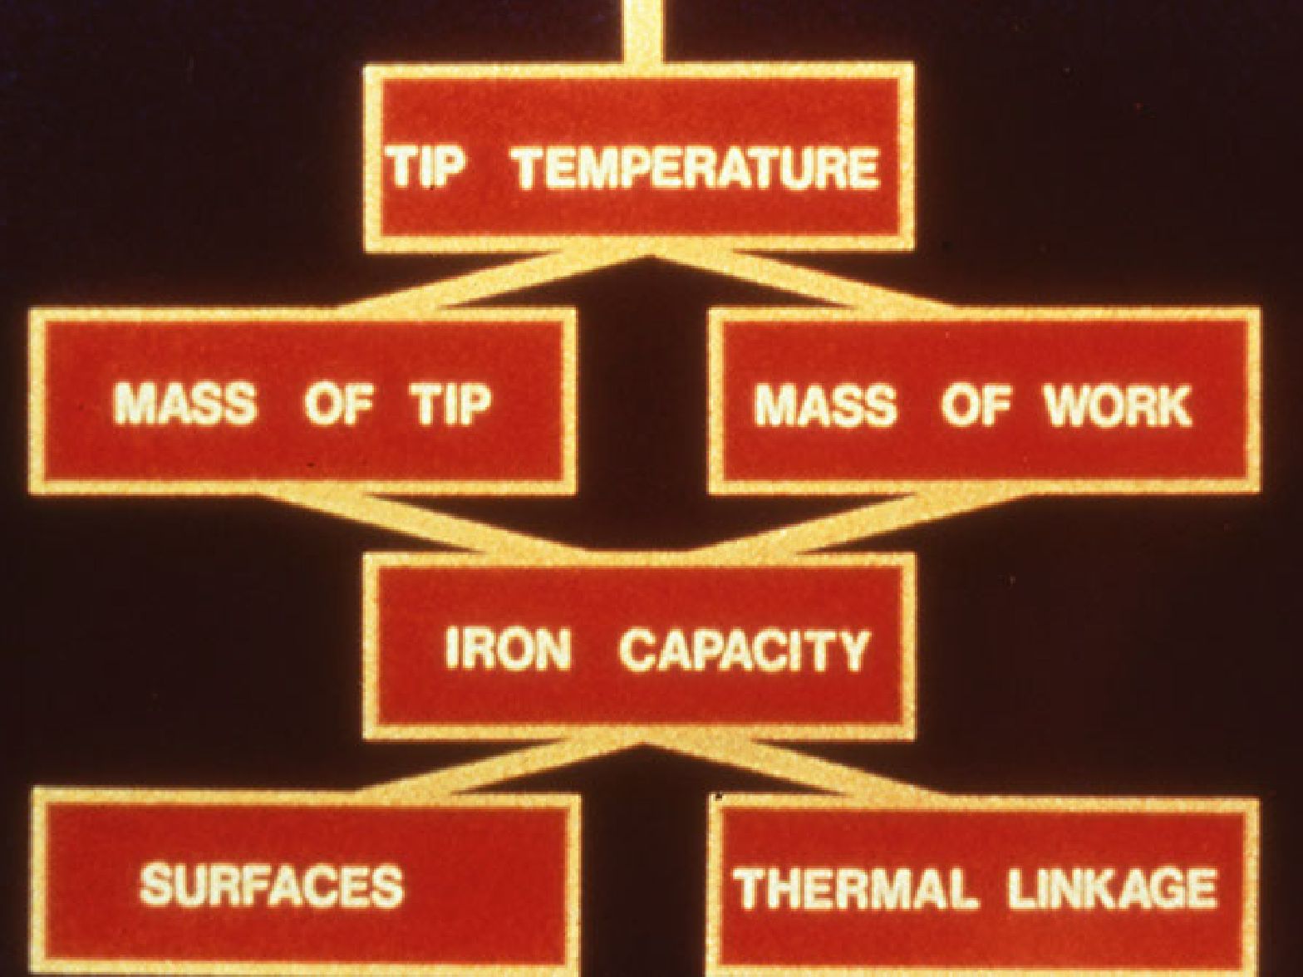

Slide 12
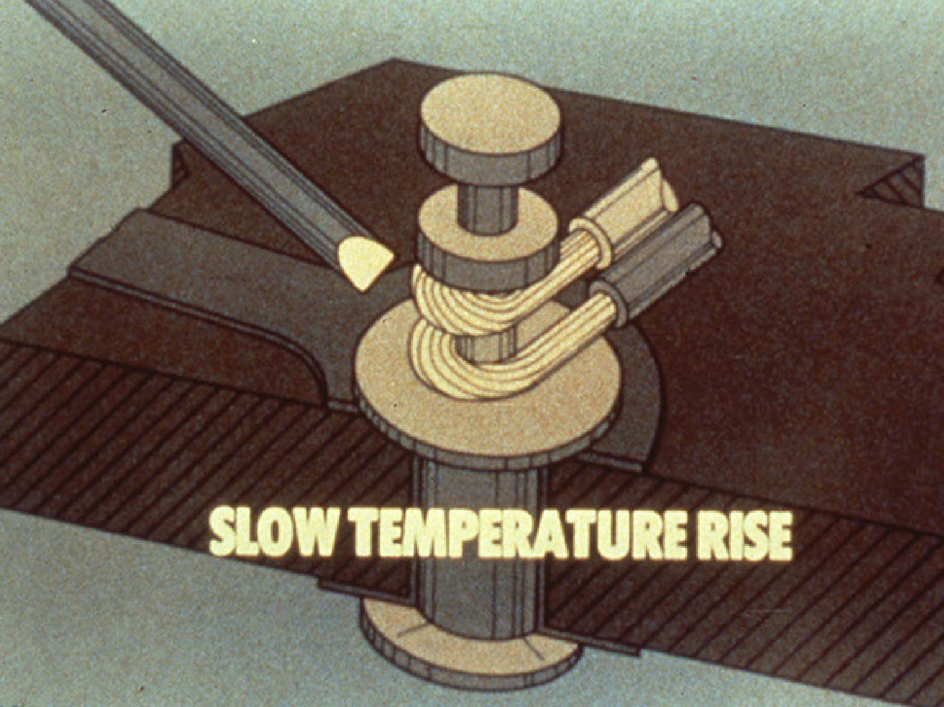
Small tip takes longer to heat the parts to the melting temperature

Slide 13
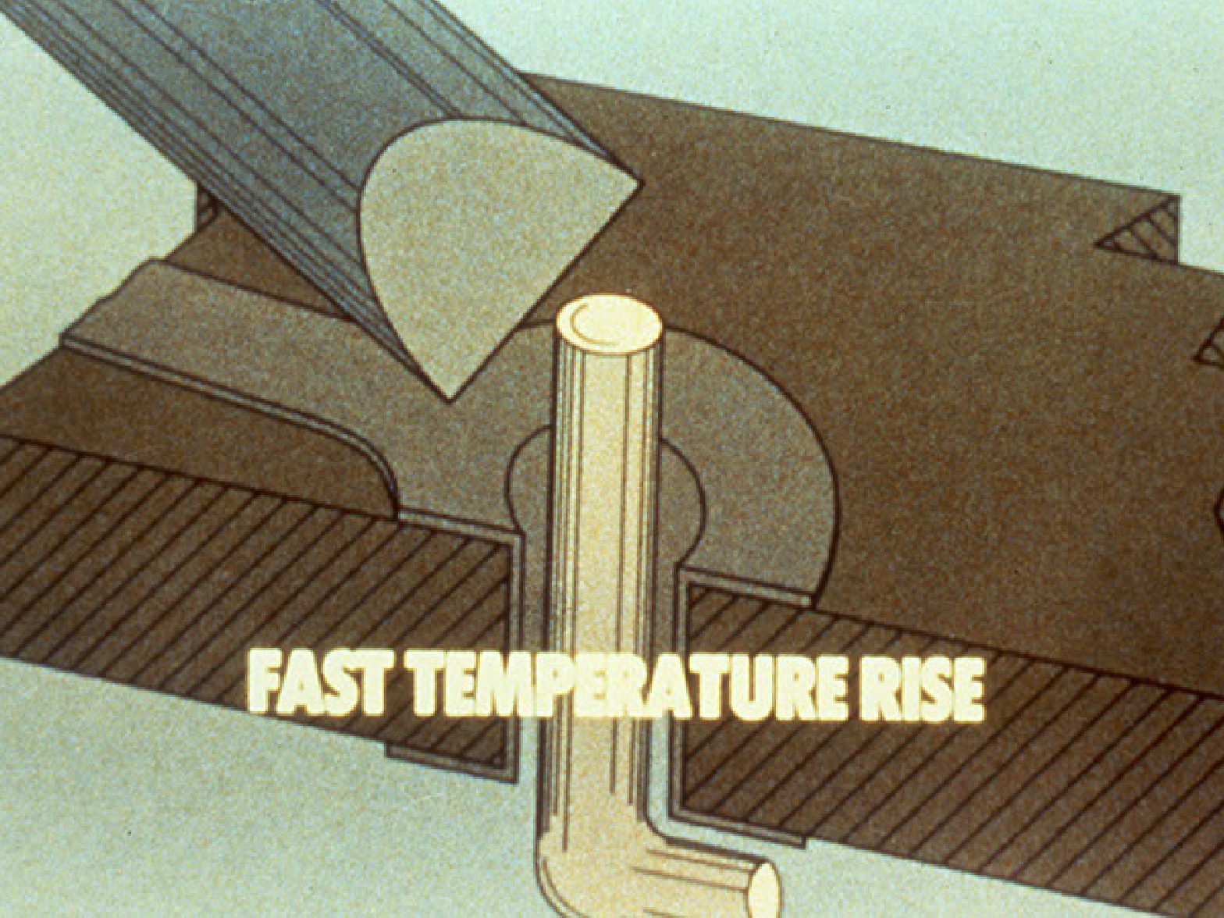
Larger tip takes less time to heat the same part to the melting temperature

Slide 14
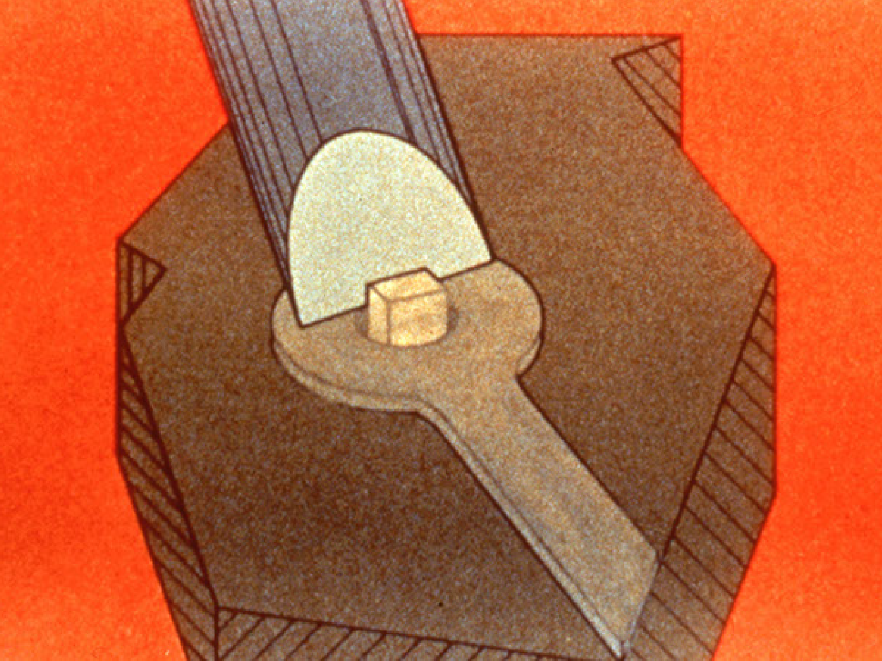
Proper sized tip

Slide 15
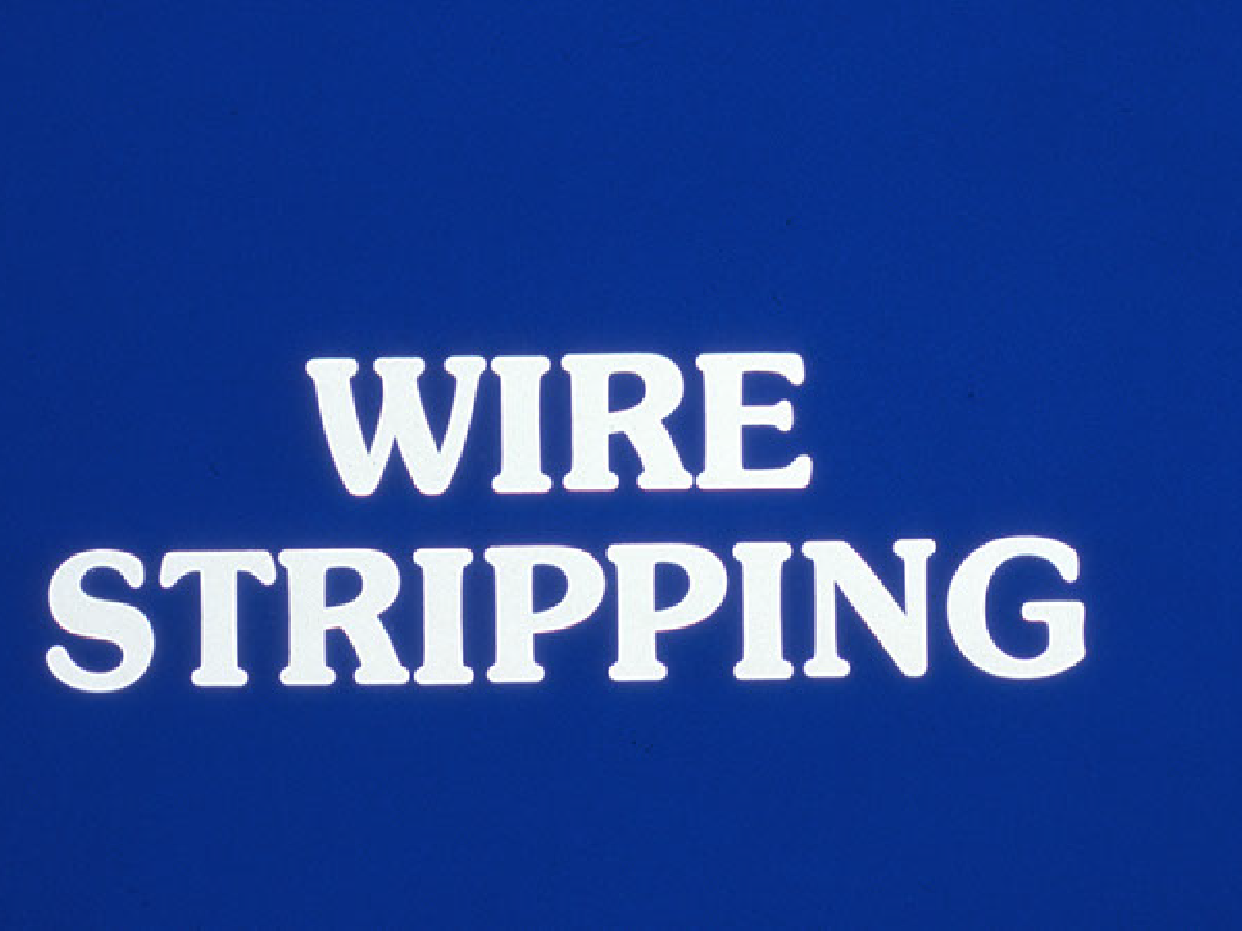

Slide 16
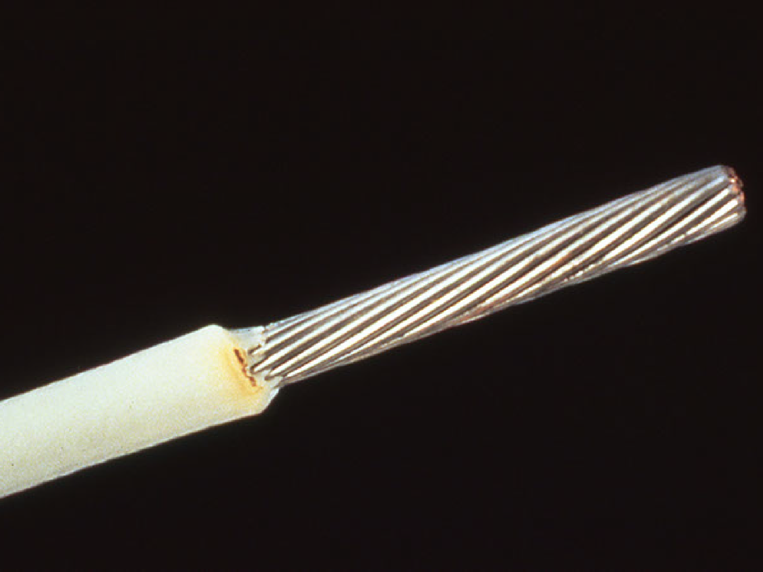
Discoloration burn to insulation -­‐ Accept

Slide 17
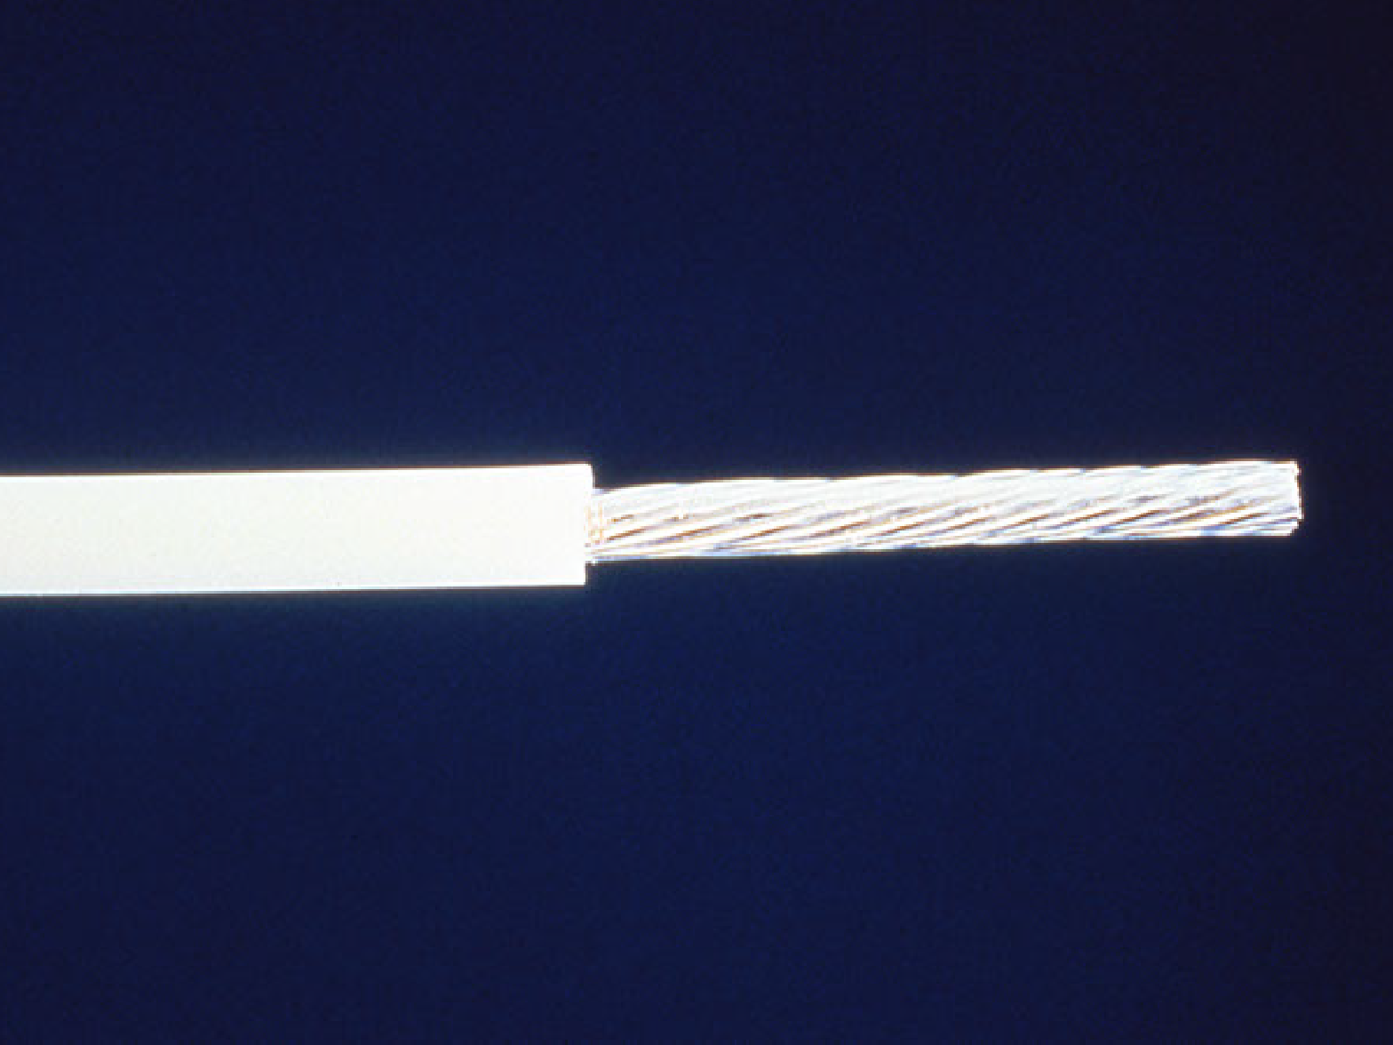
Cut or nicked leads or wires -­‐ Reject

Slide 18
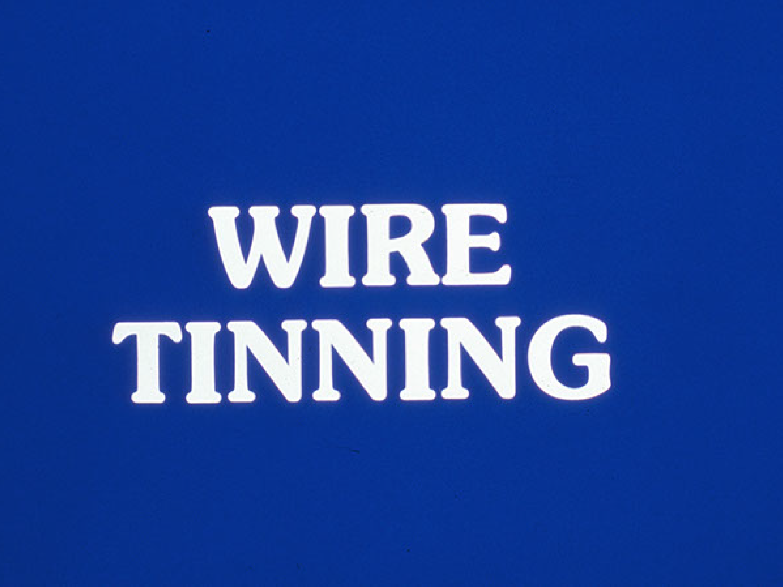

Slide 19
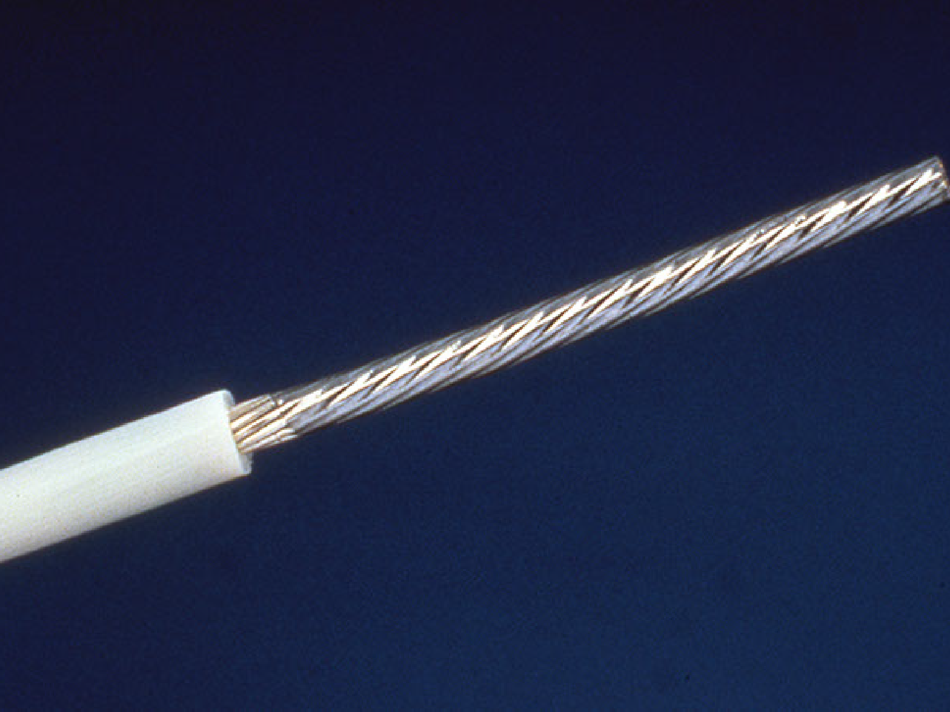
Preferred tinning of stranded wire with heat sink -­‐ Accept

Slide 20


Slide 21
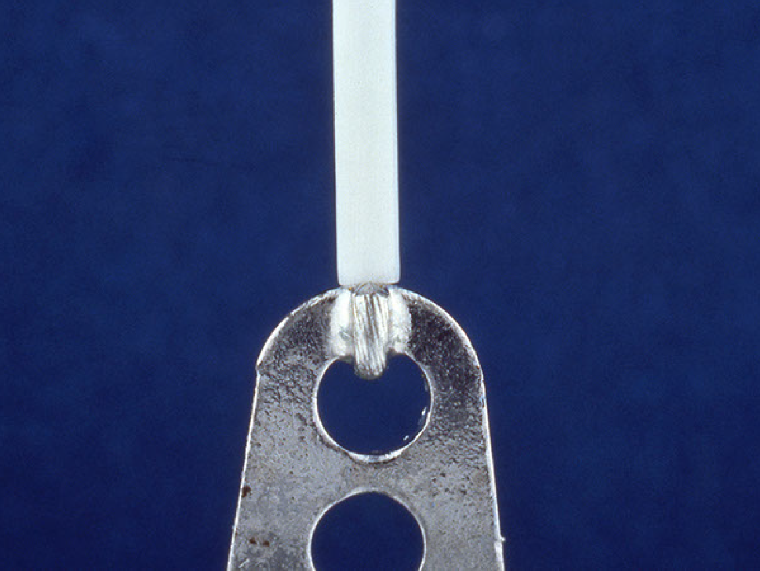
Minimum insulation clearance -­‐ Accept

Slide 22
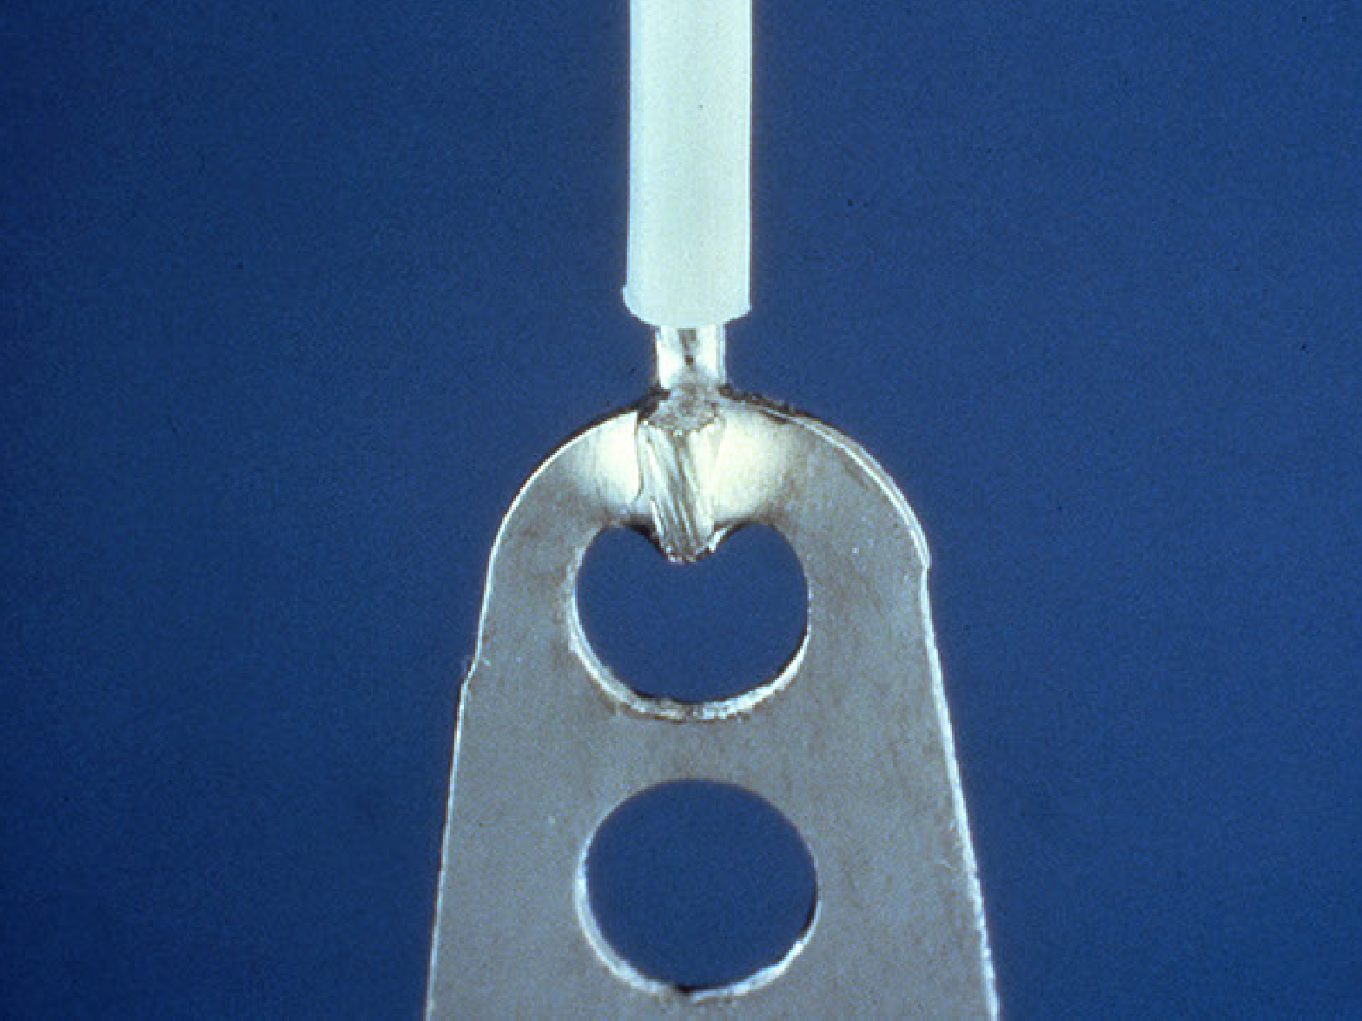
Preferred insulation clearance -­‐ Accept

Slide 23
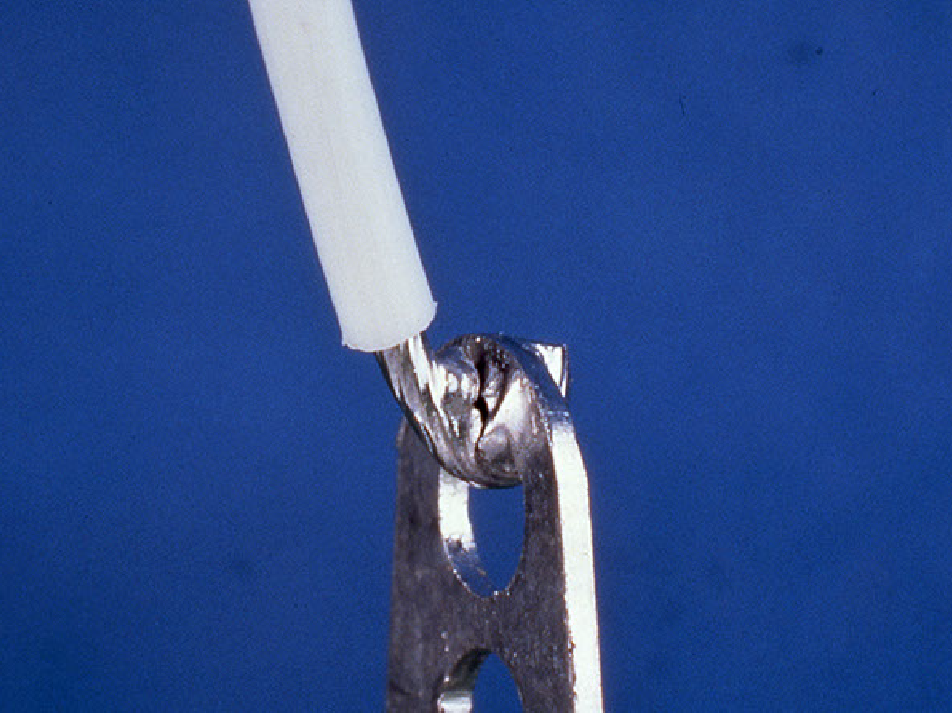
Disturbed/Fractured connection -­‐ Reject

Slide 24


Slide 25


Slide 26
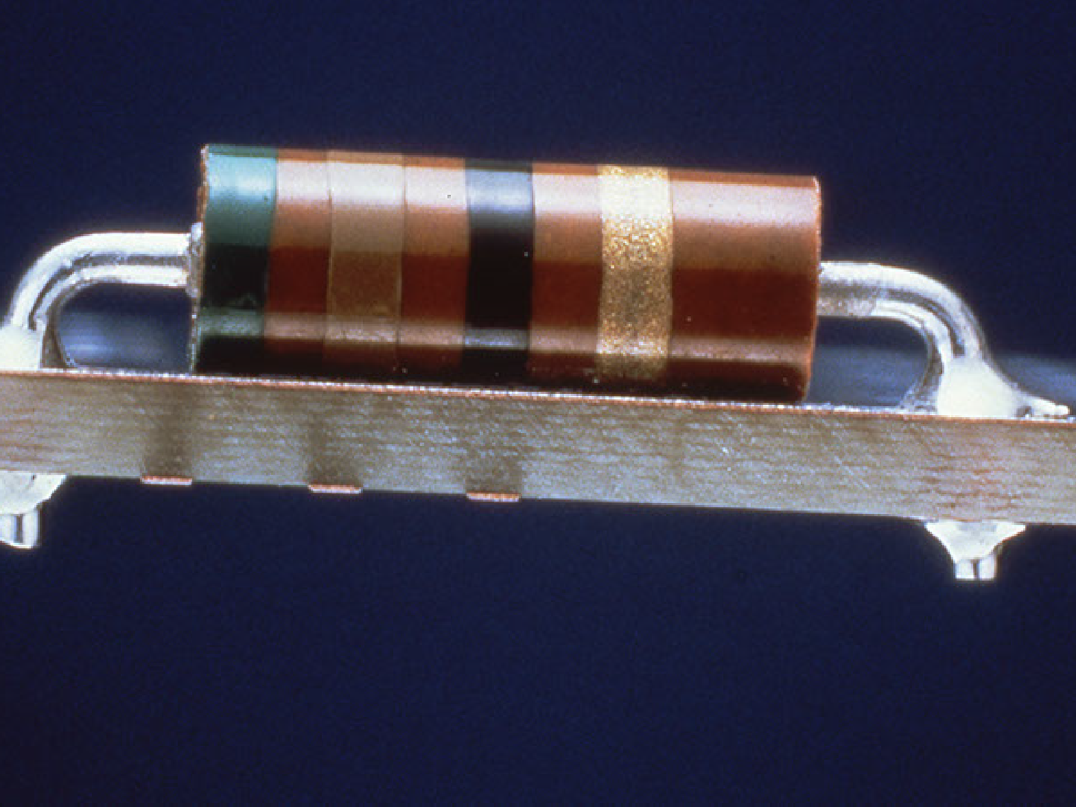
Axial component mounting -­‐ Accept

Slide 27
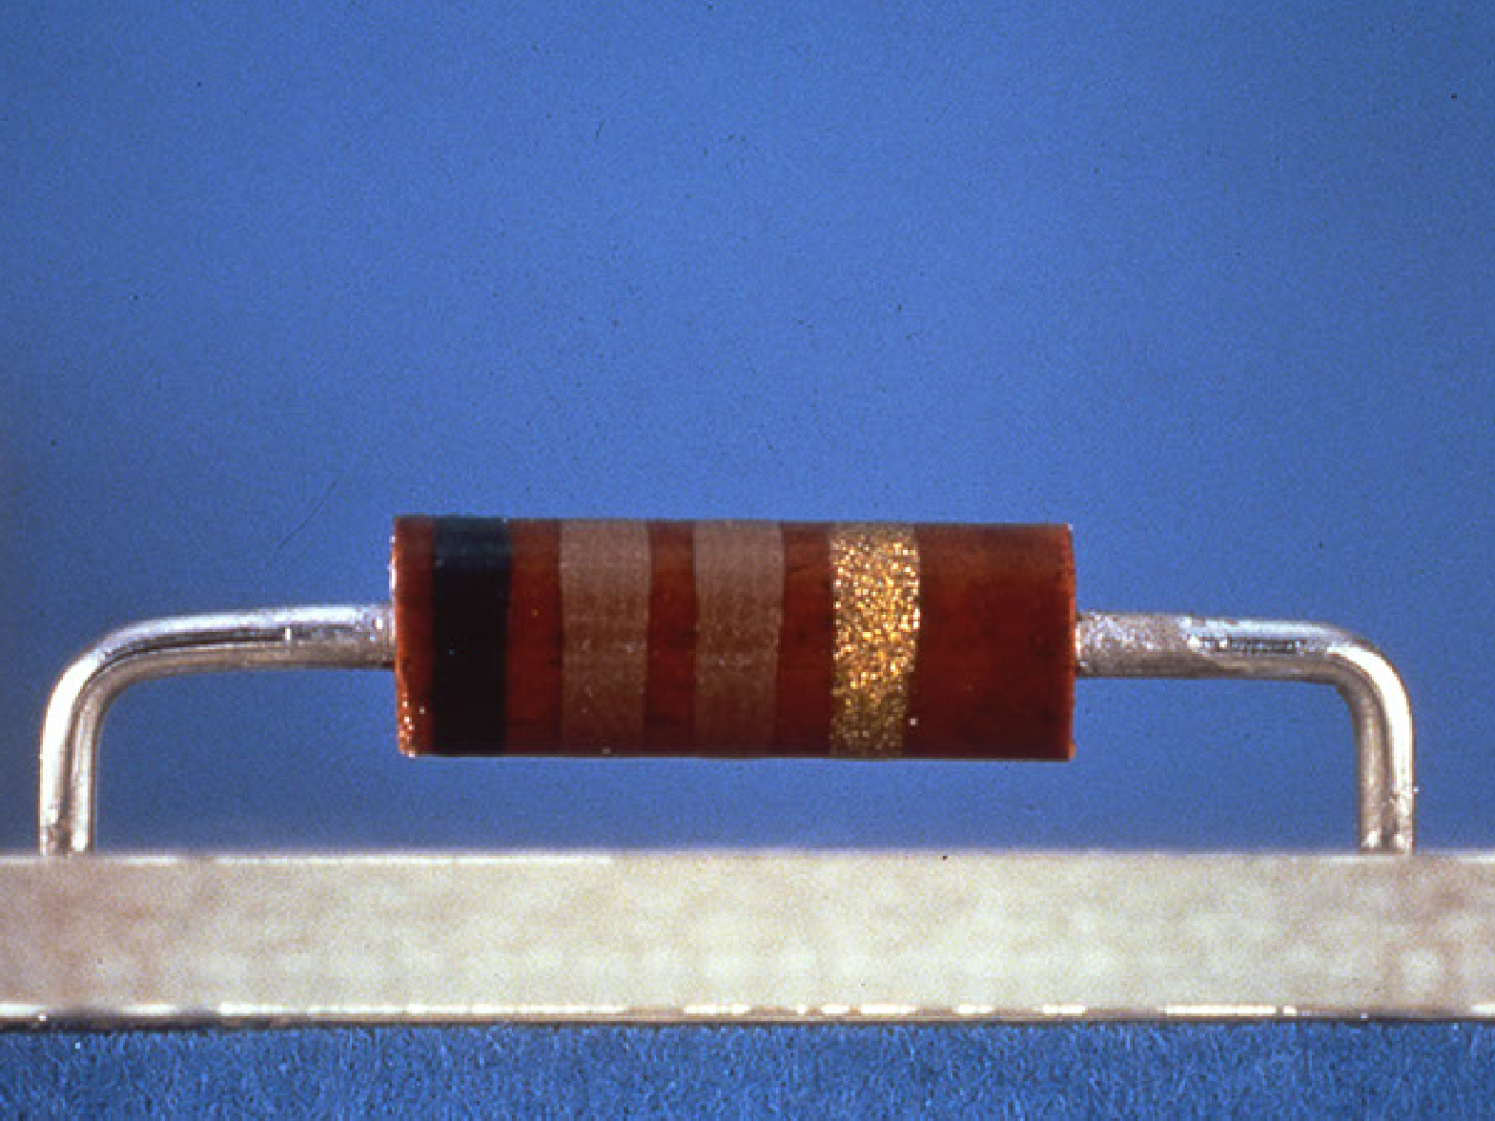
Axial component not seated against board -­‐ Reject

Slide 28


Slide 29
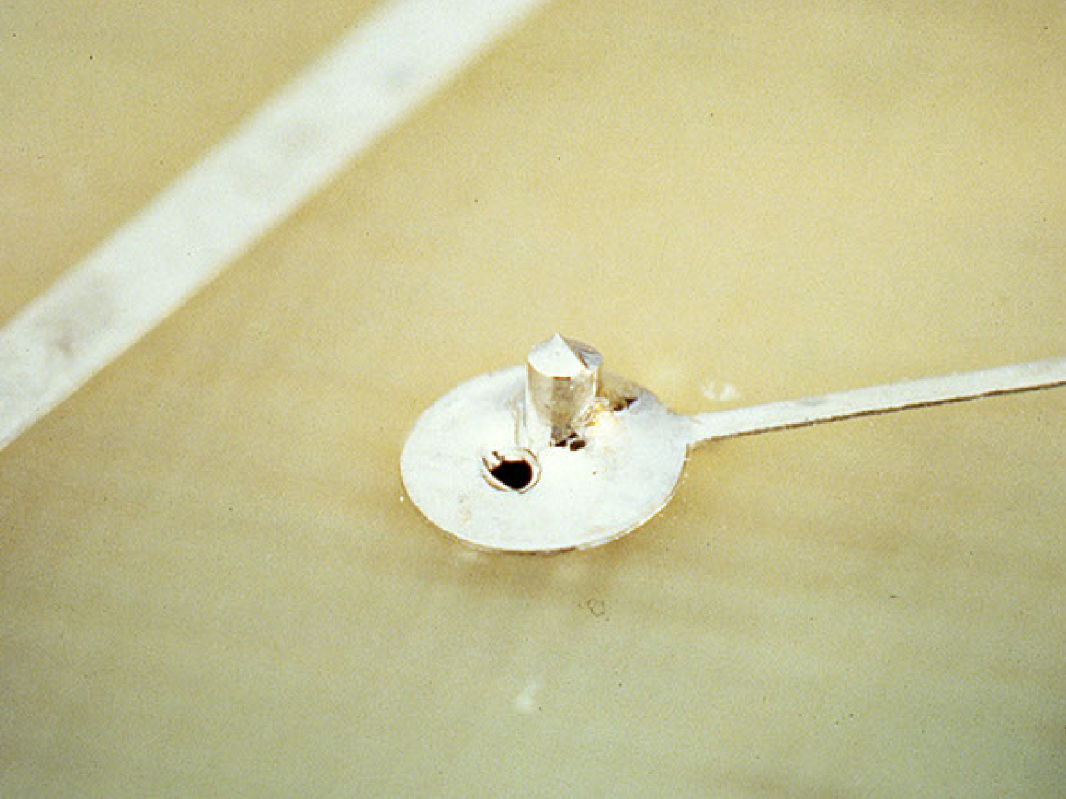
Blowhole -­‐ Reject

Slide 30
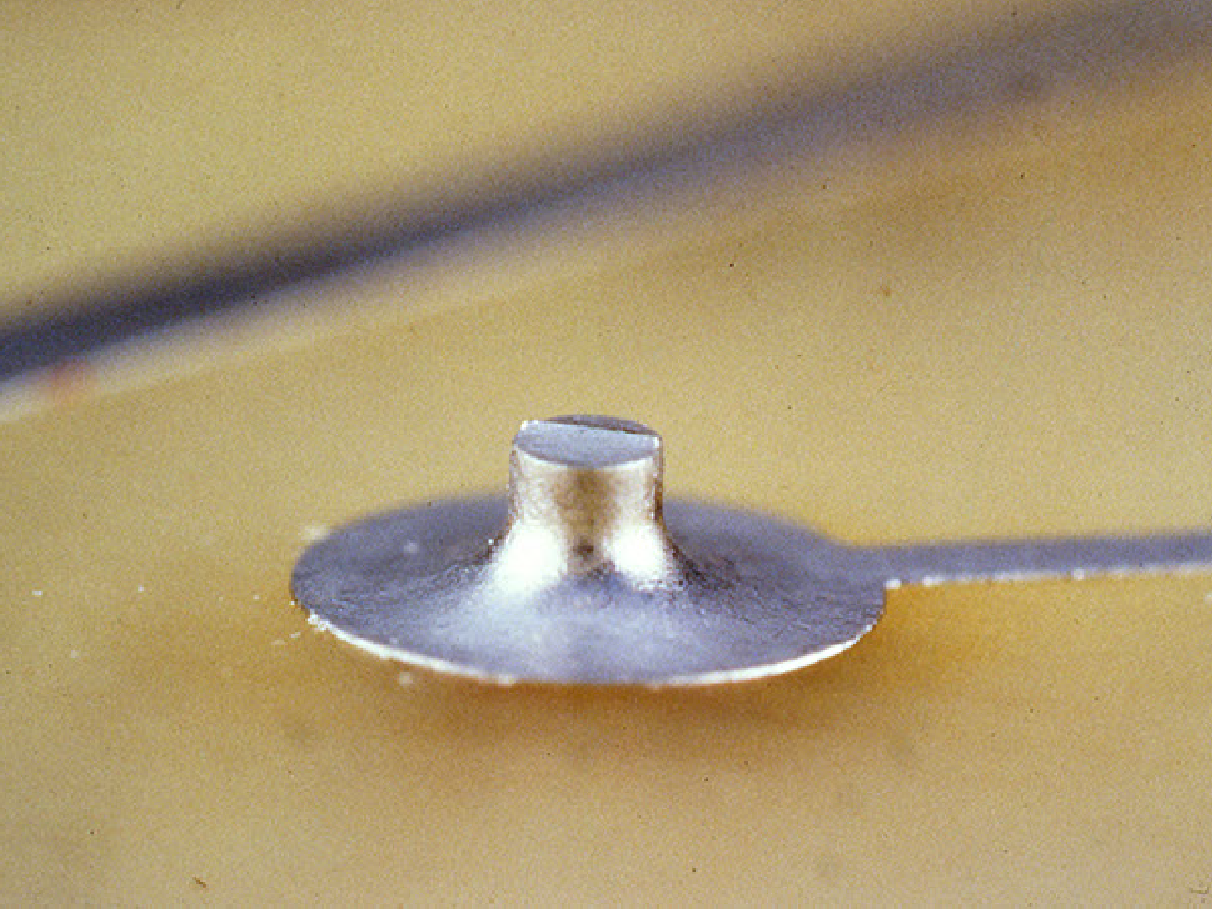
Preferred solder -­‐ Accept

Slide 31
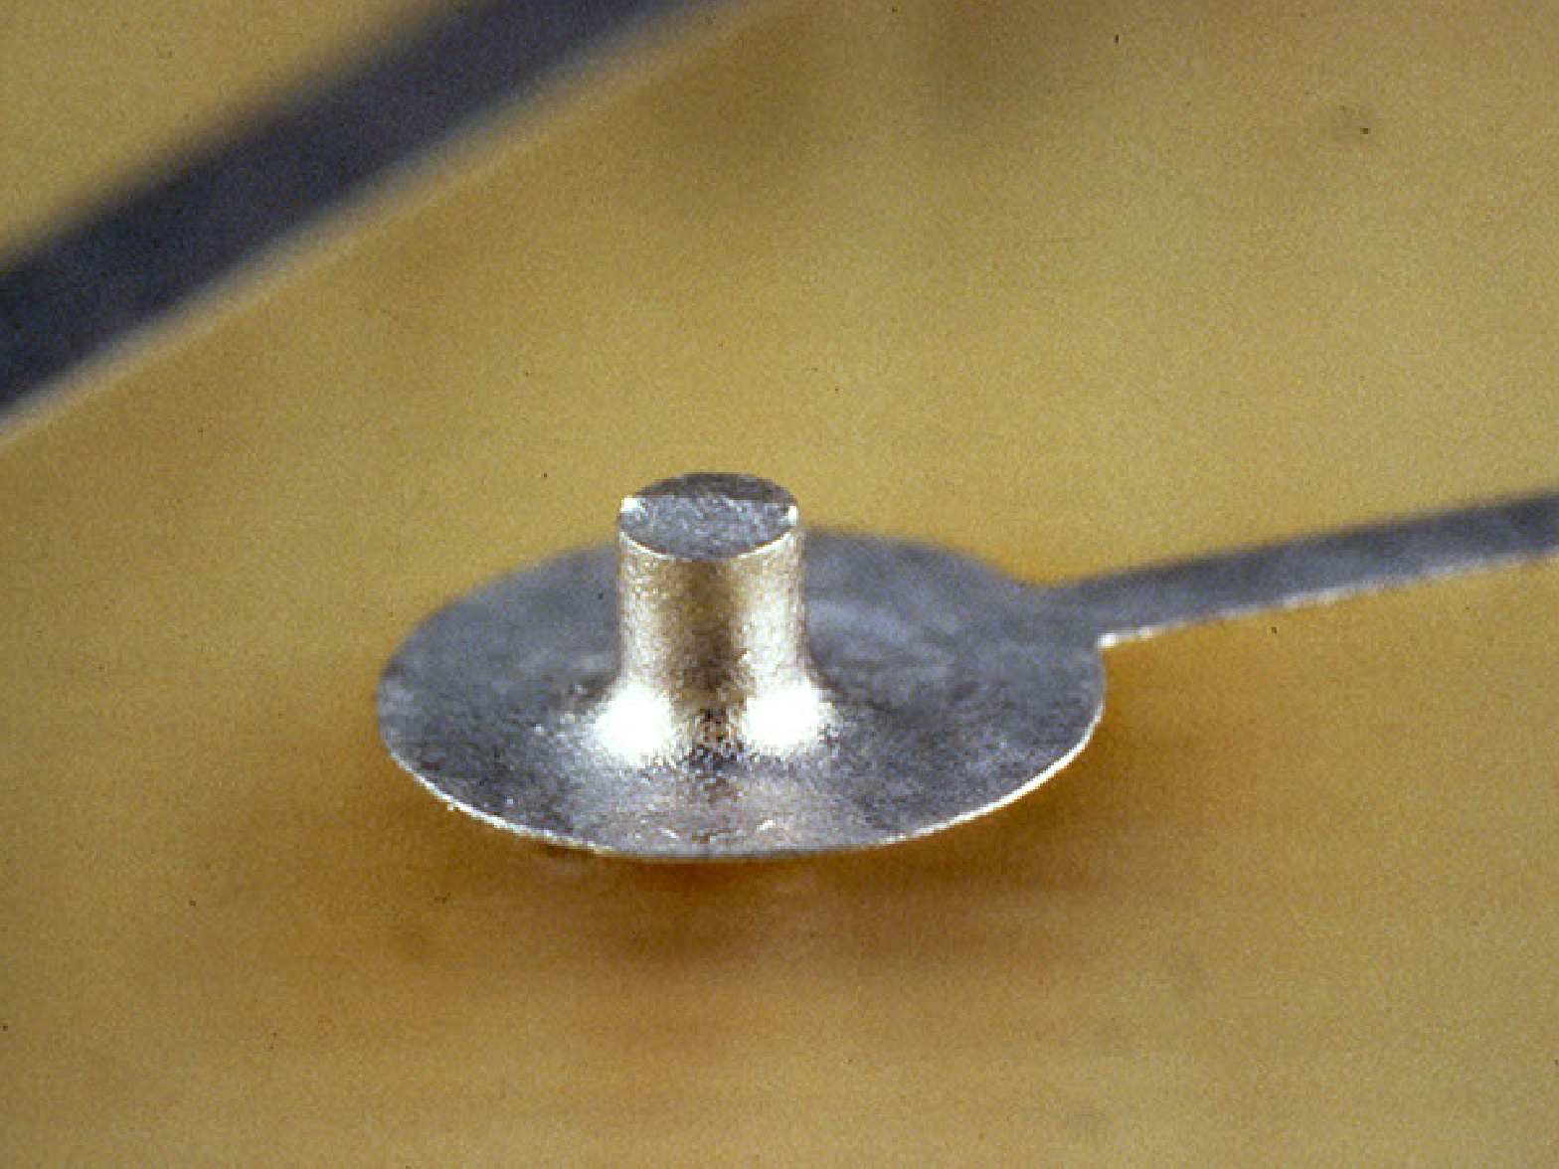
Minimum solder -­‐ Accept

Slide 32
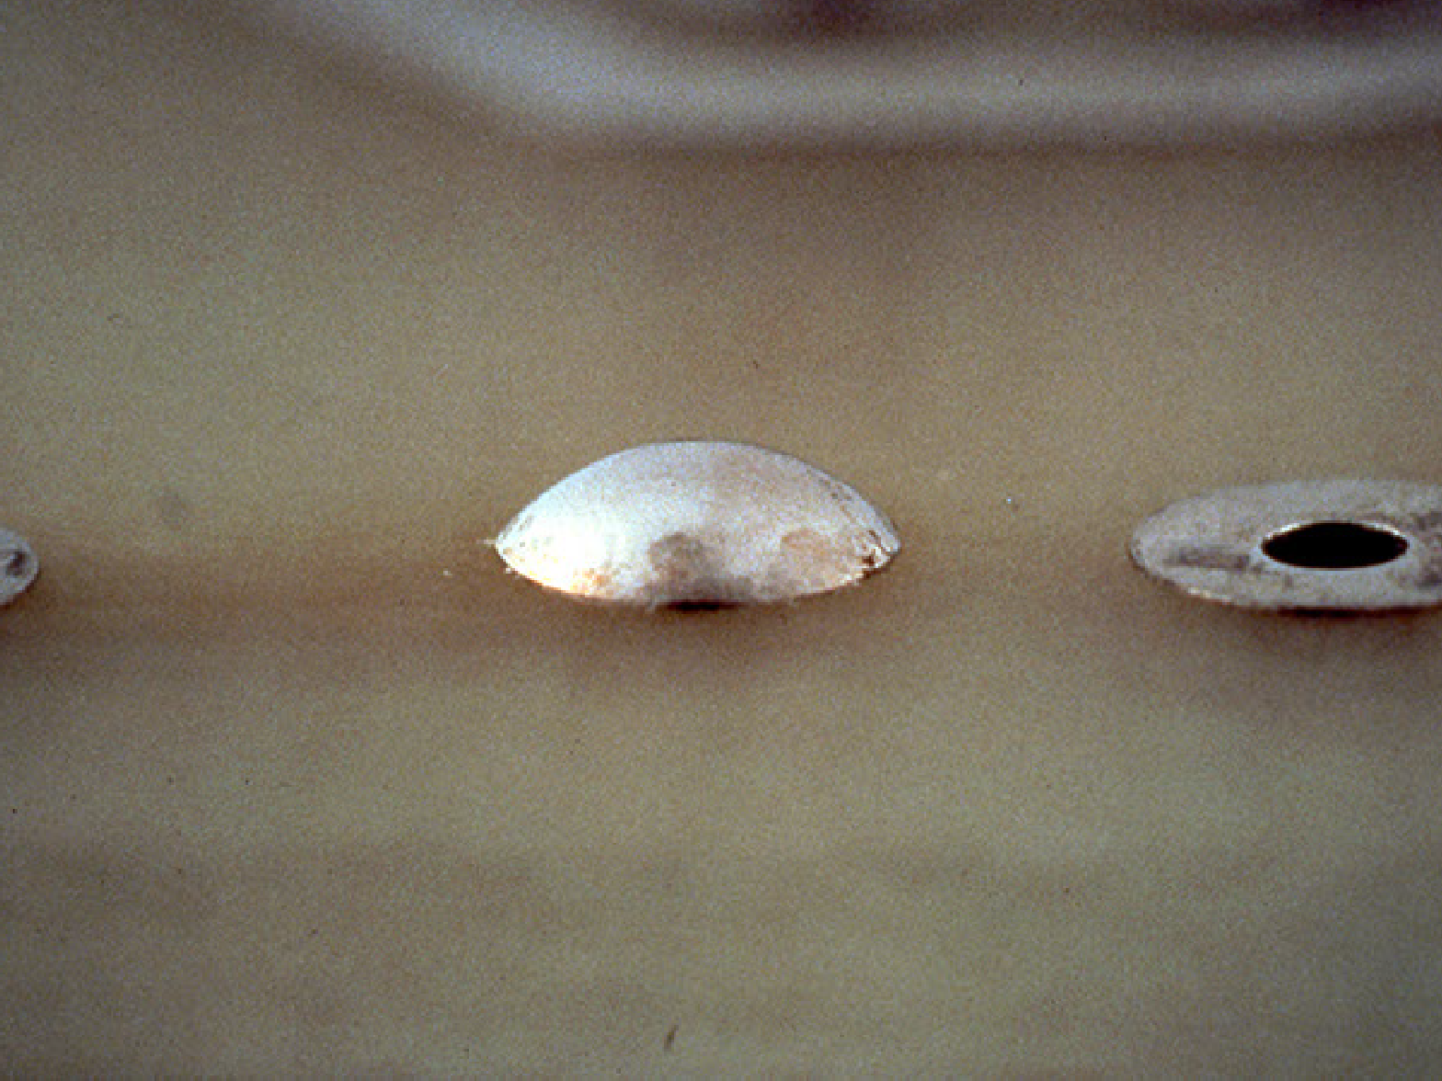
Excessive solder -­‐ Reject

Slide 33
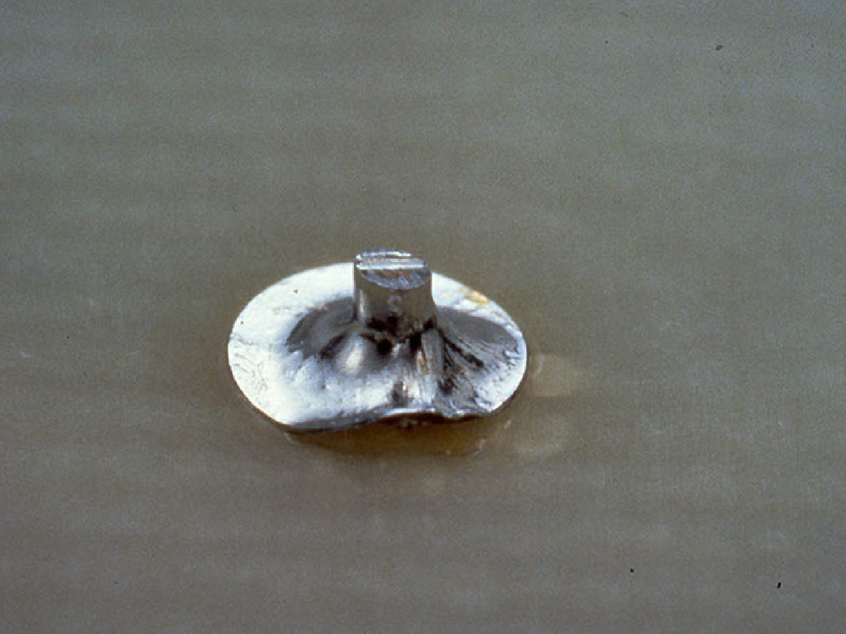
Lifed pad -­‐ Reject

Slide 34


Slide 35
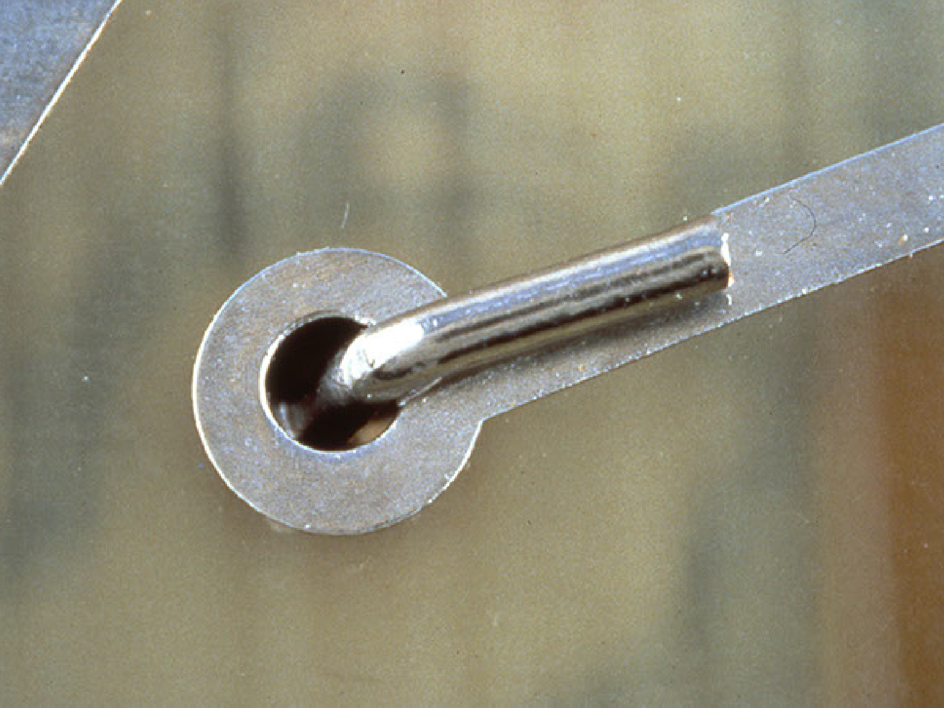
Clinched lead -­‐ Accept

Slide 36
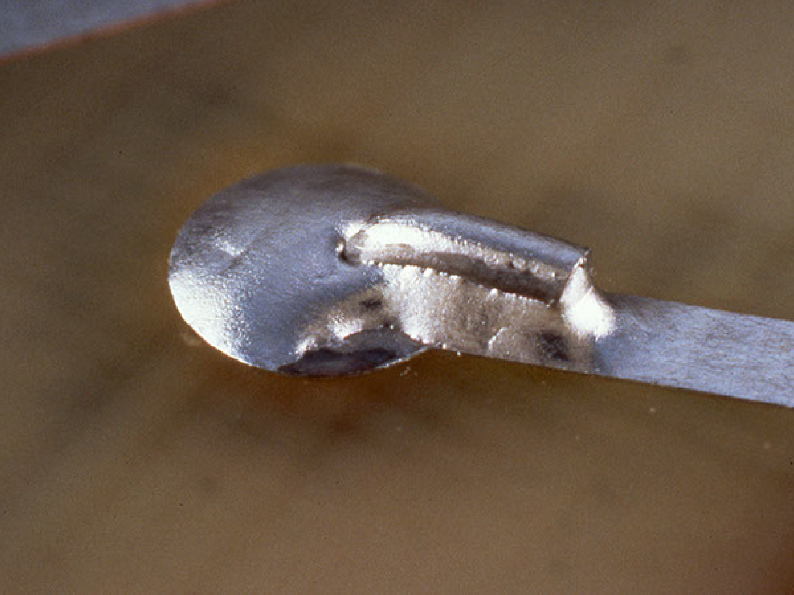
Cold solder, non weQng -­‐ Reject

Slide 37
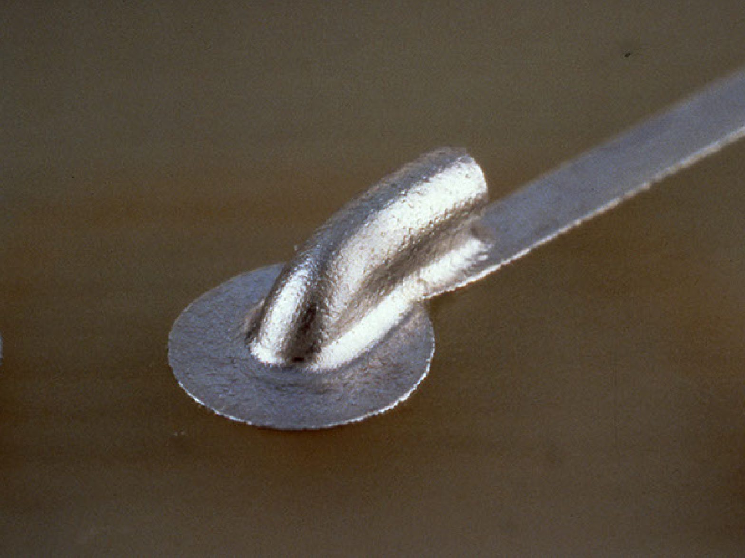
Minimum solder (should cover pad) -­‐ Accept

Slide 38
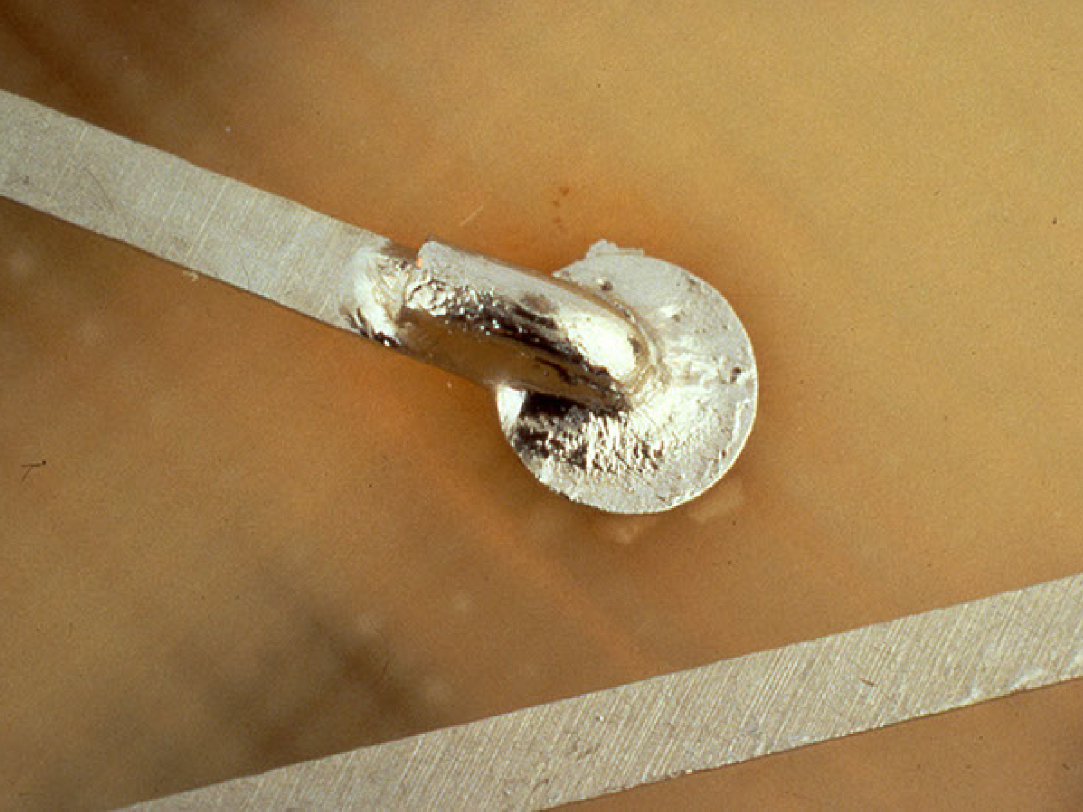
Grainy -­‐ Reject

Slide 39
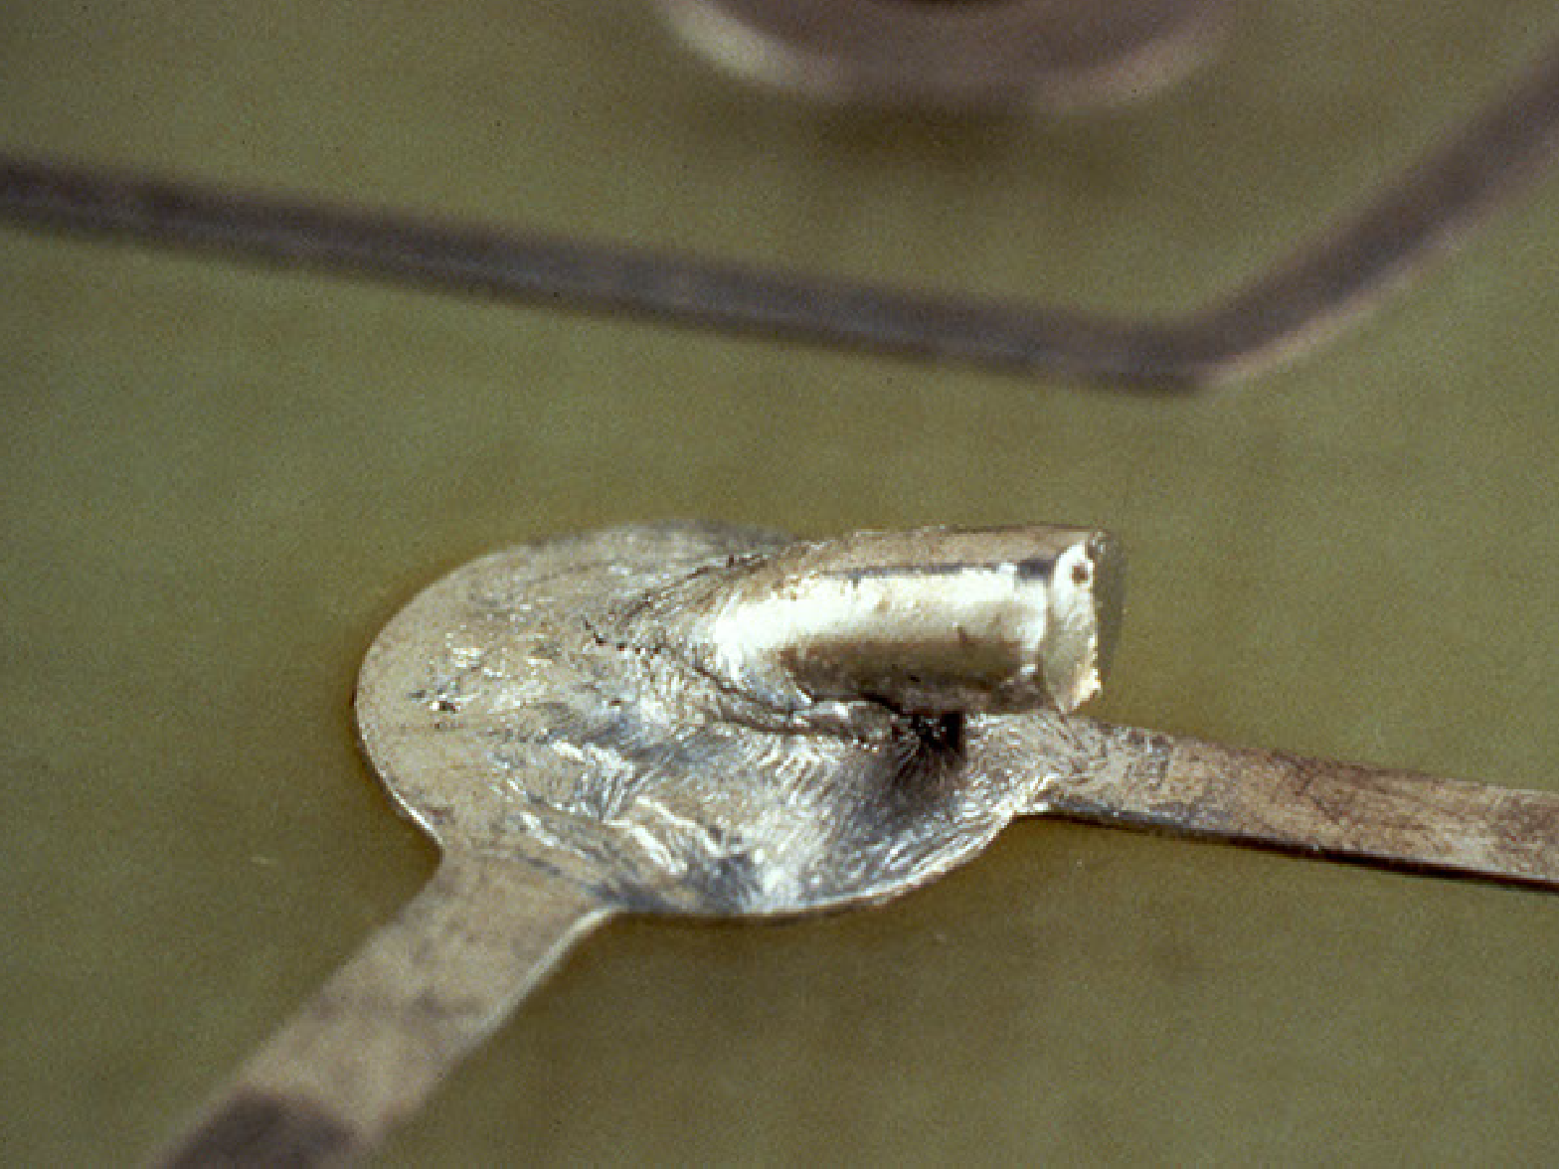
Disturbed solder -­‐ Reject

Slide 40
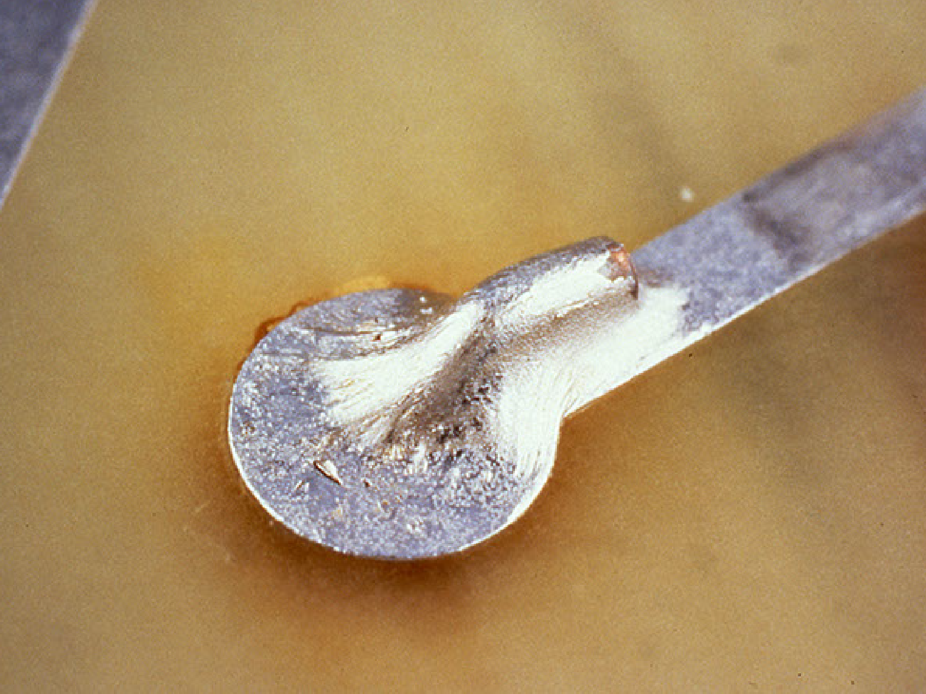
Overheated -­‐ Reject

Slide 41
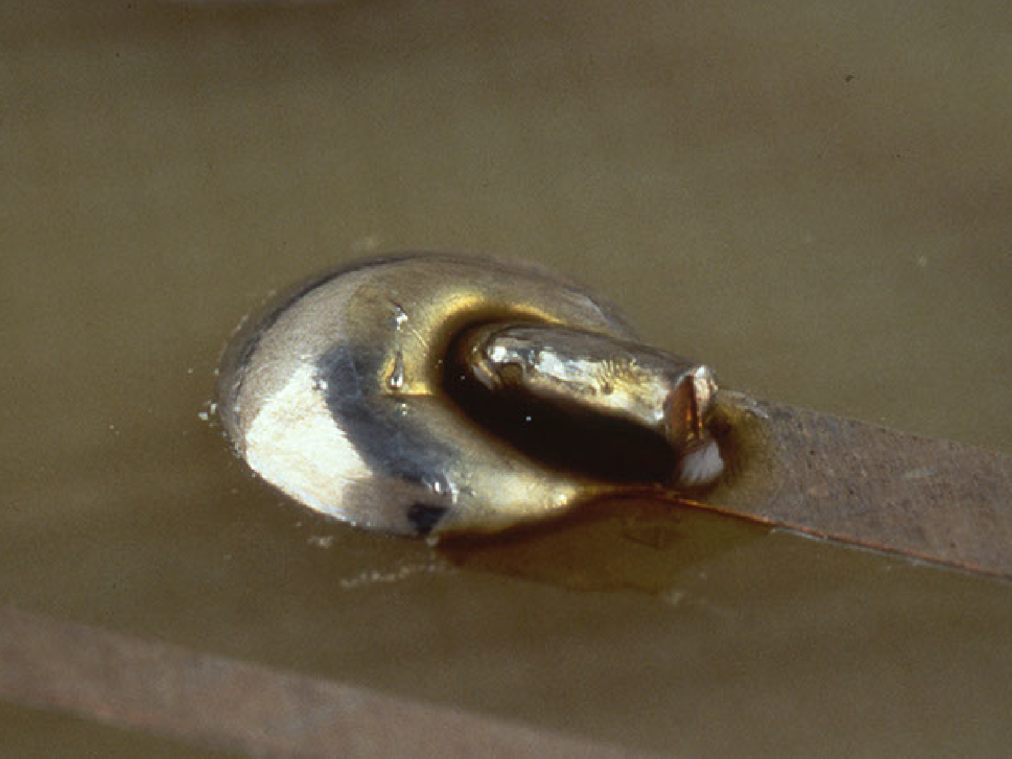
Rosin -­‐ Reject

Slide 42
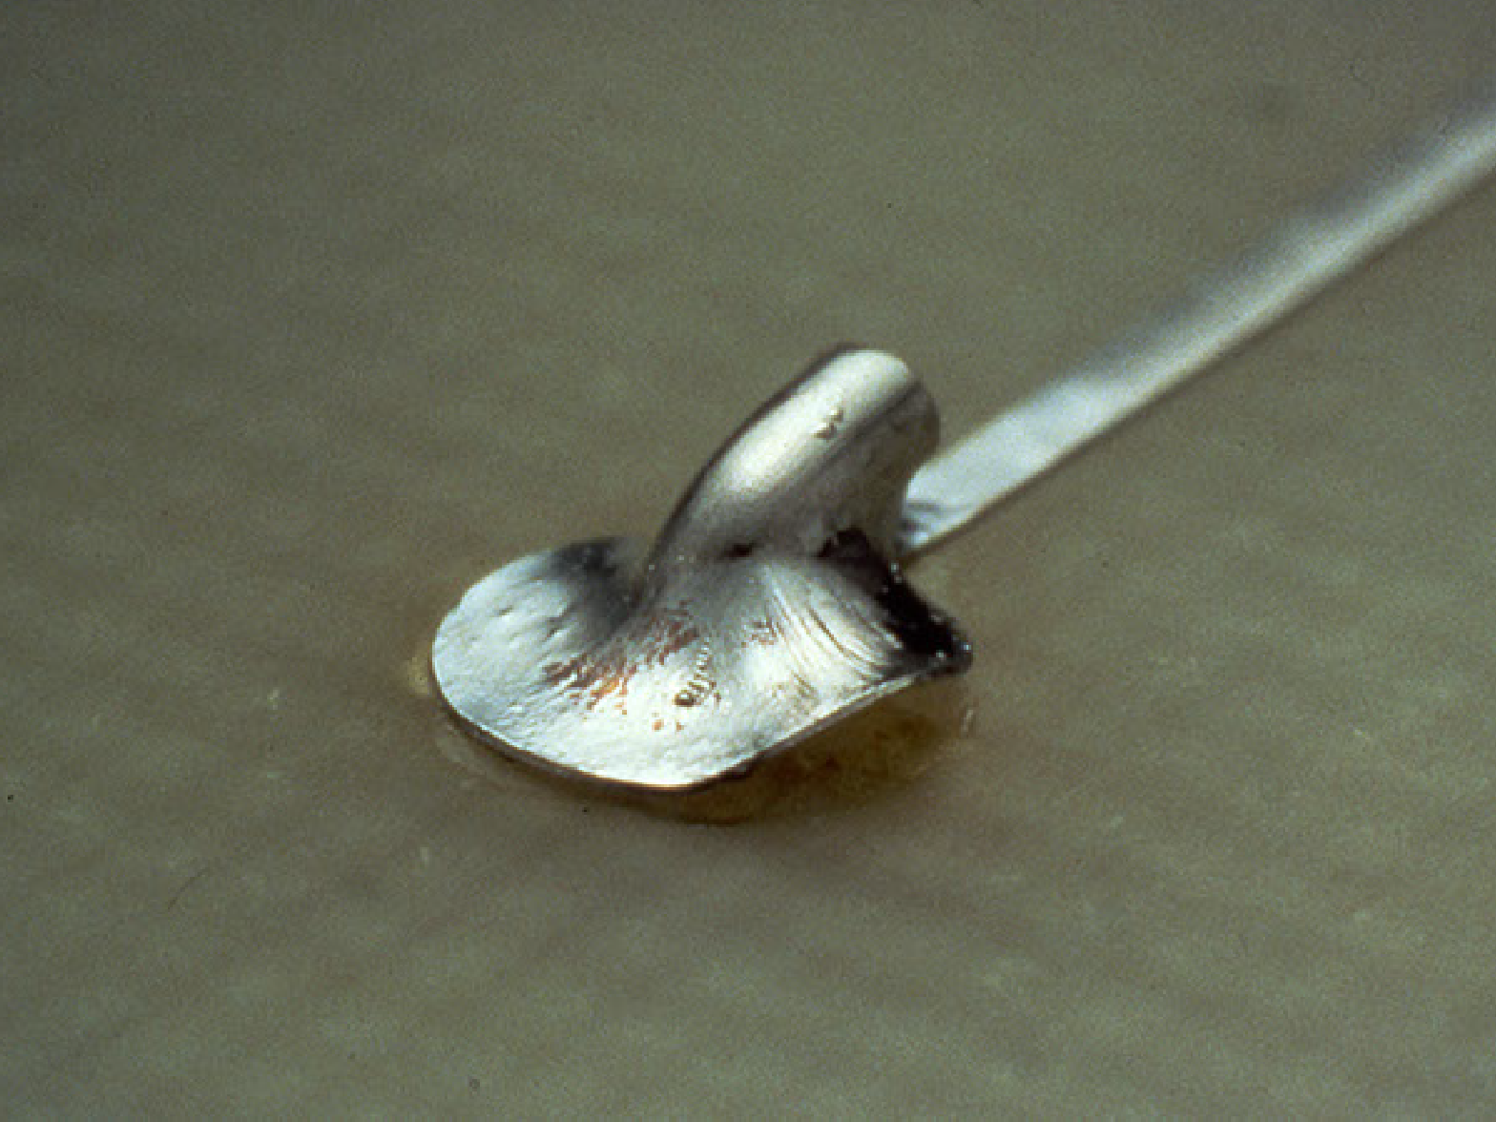
Lifed pad -­‐ Reject

Slide 43


Slide 44
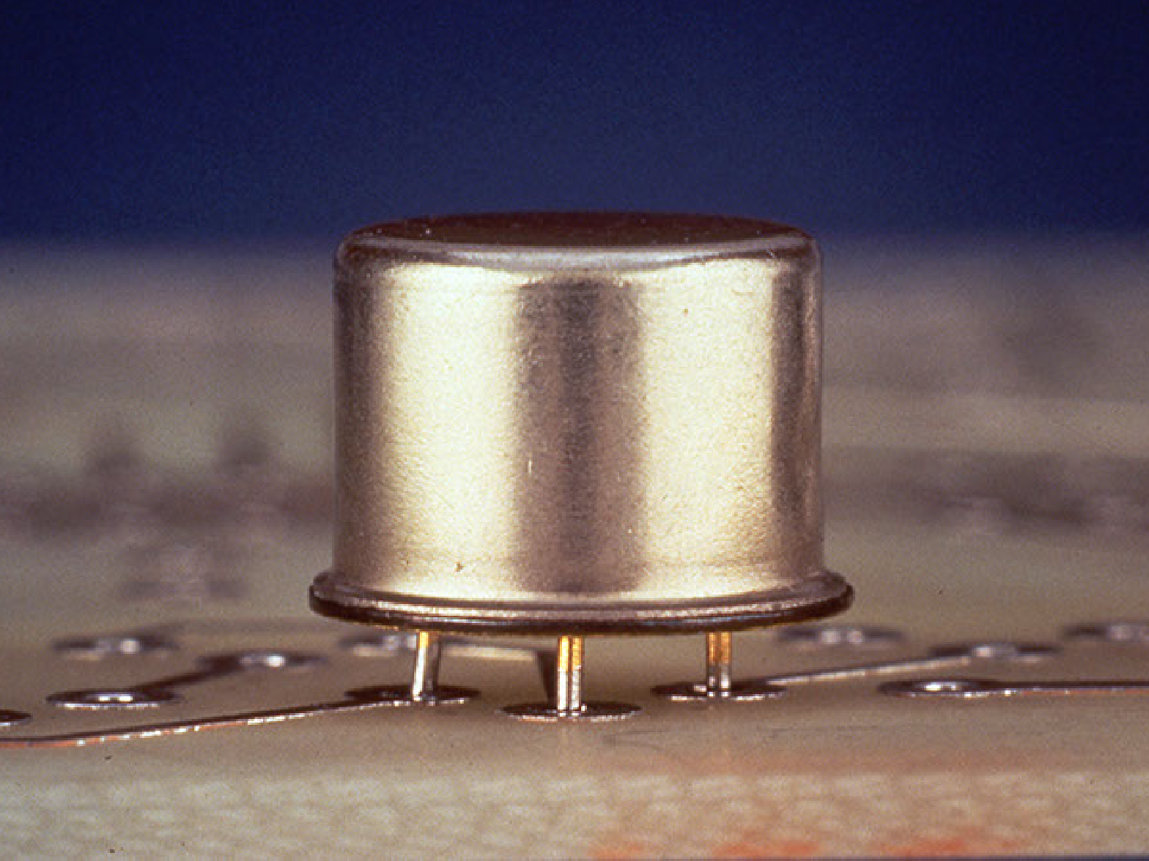
T05 transistor component mounting -­‐ Accept

Slide 45
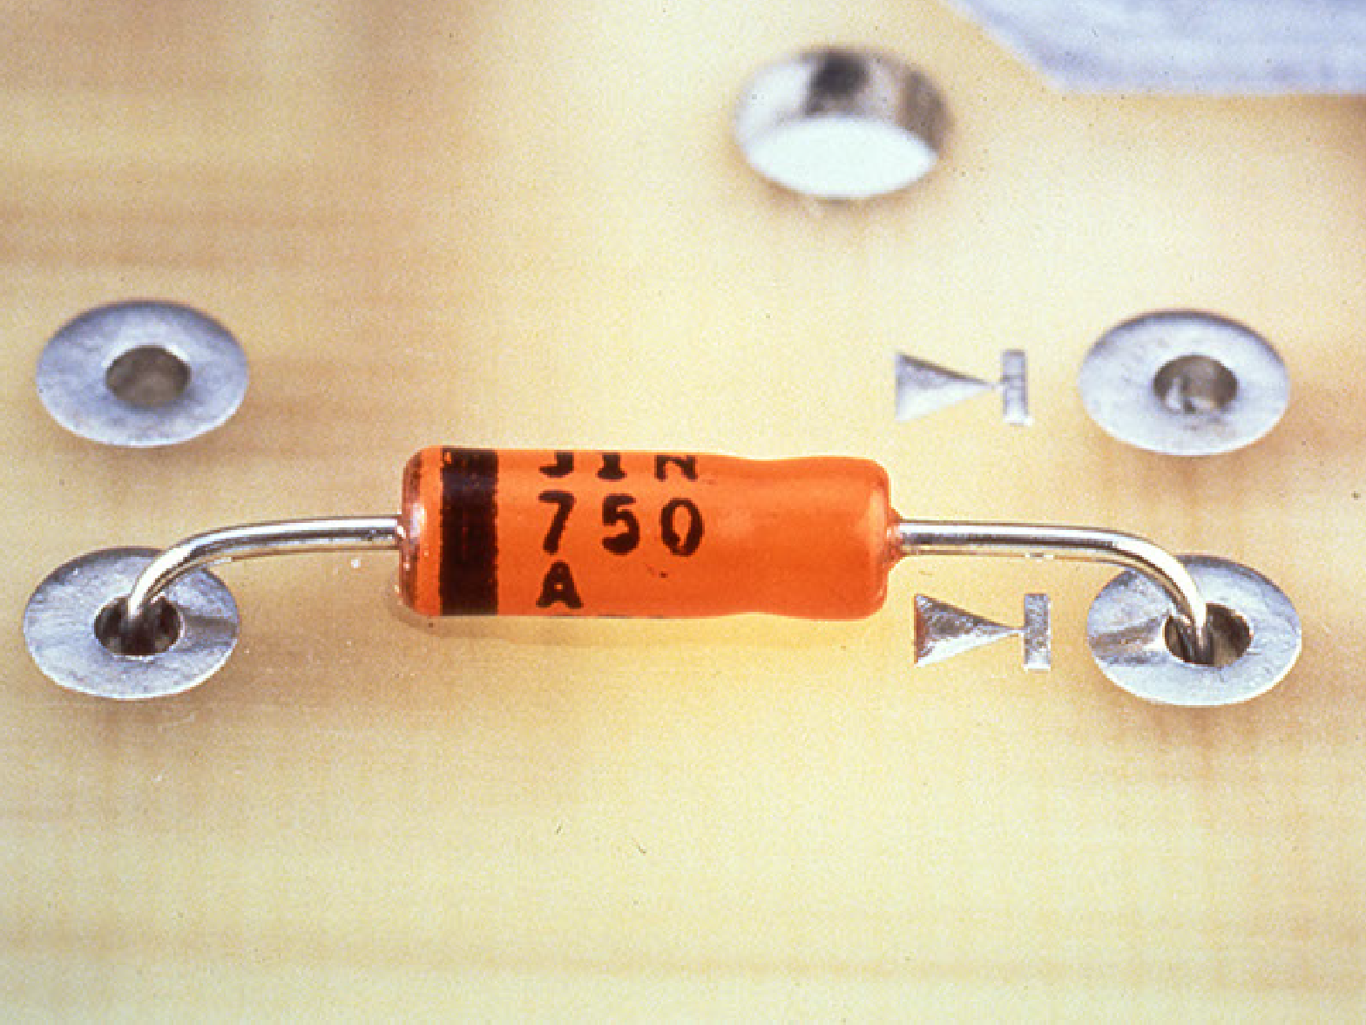
Reversed polarity -­‐ Reject

Slide 46
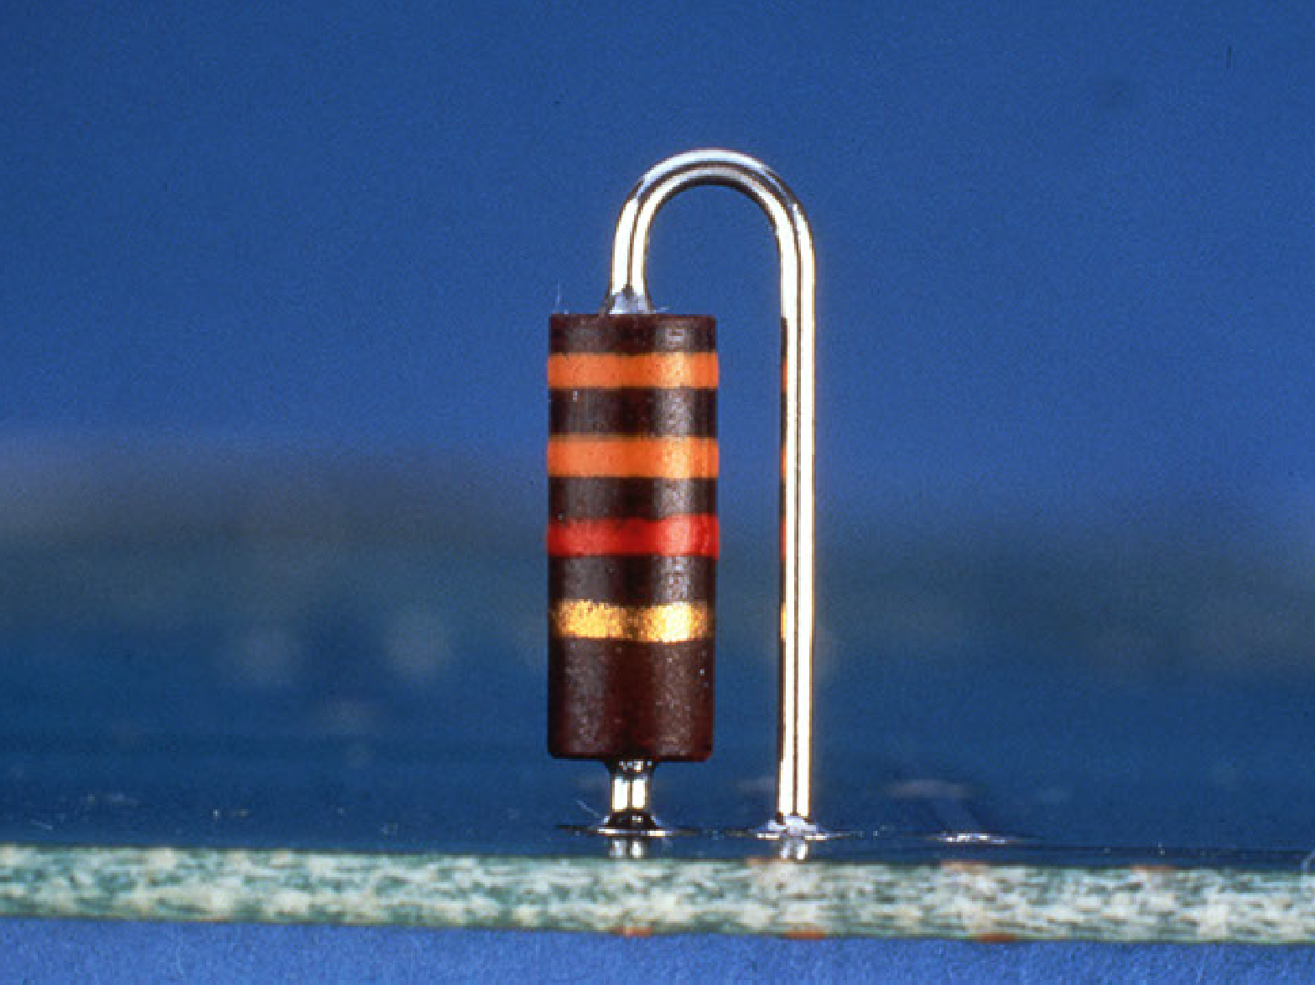
Vertical mounted axial lead component -­‐ Accept

Slide 47


Slide 48
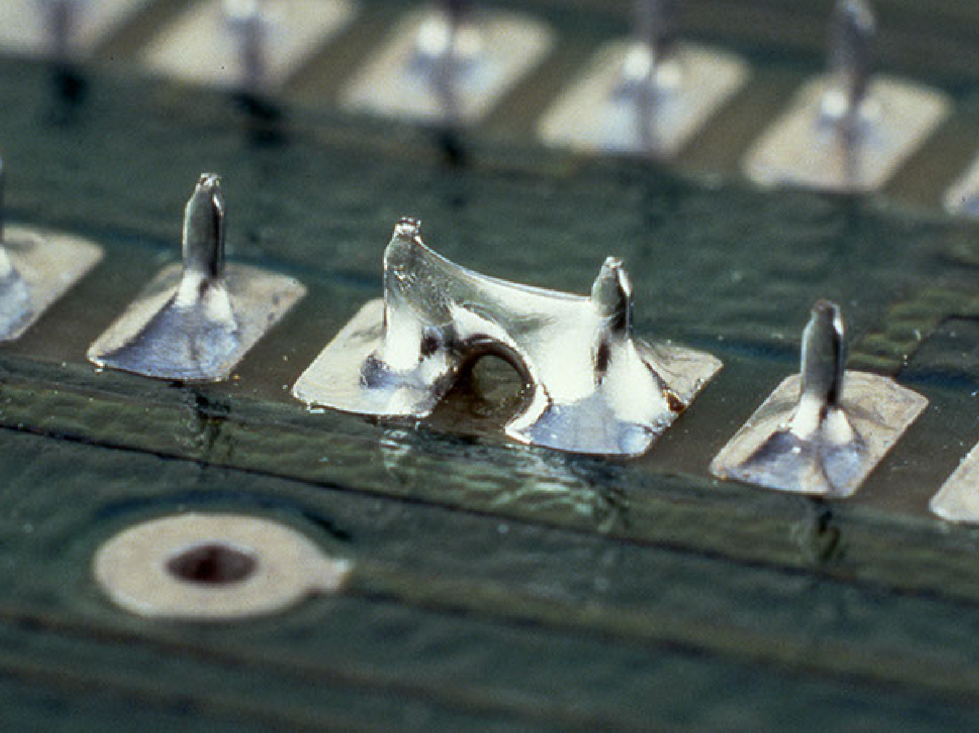
Solder bridge between leads -­‐ Reject

Slide 49
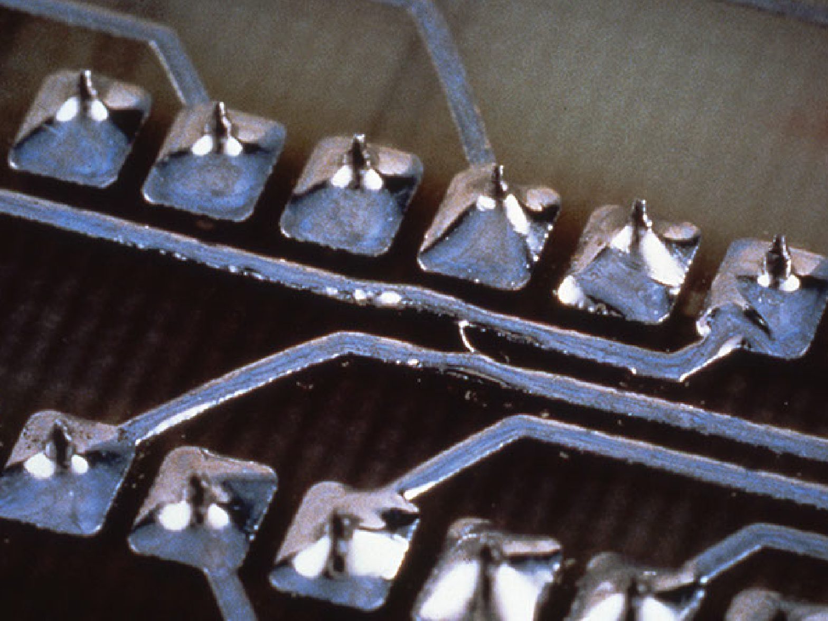
Solder bridge between leads -­‐ Reject

Slide 50
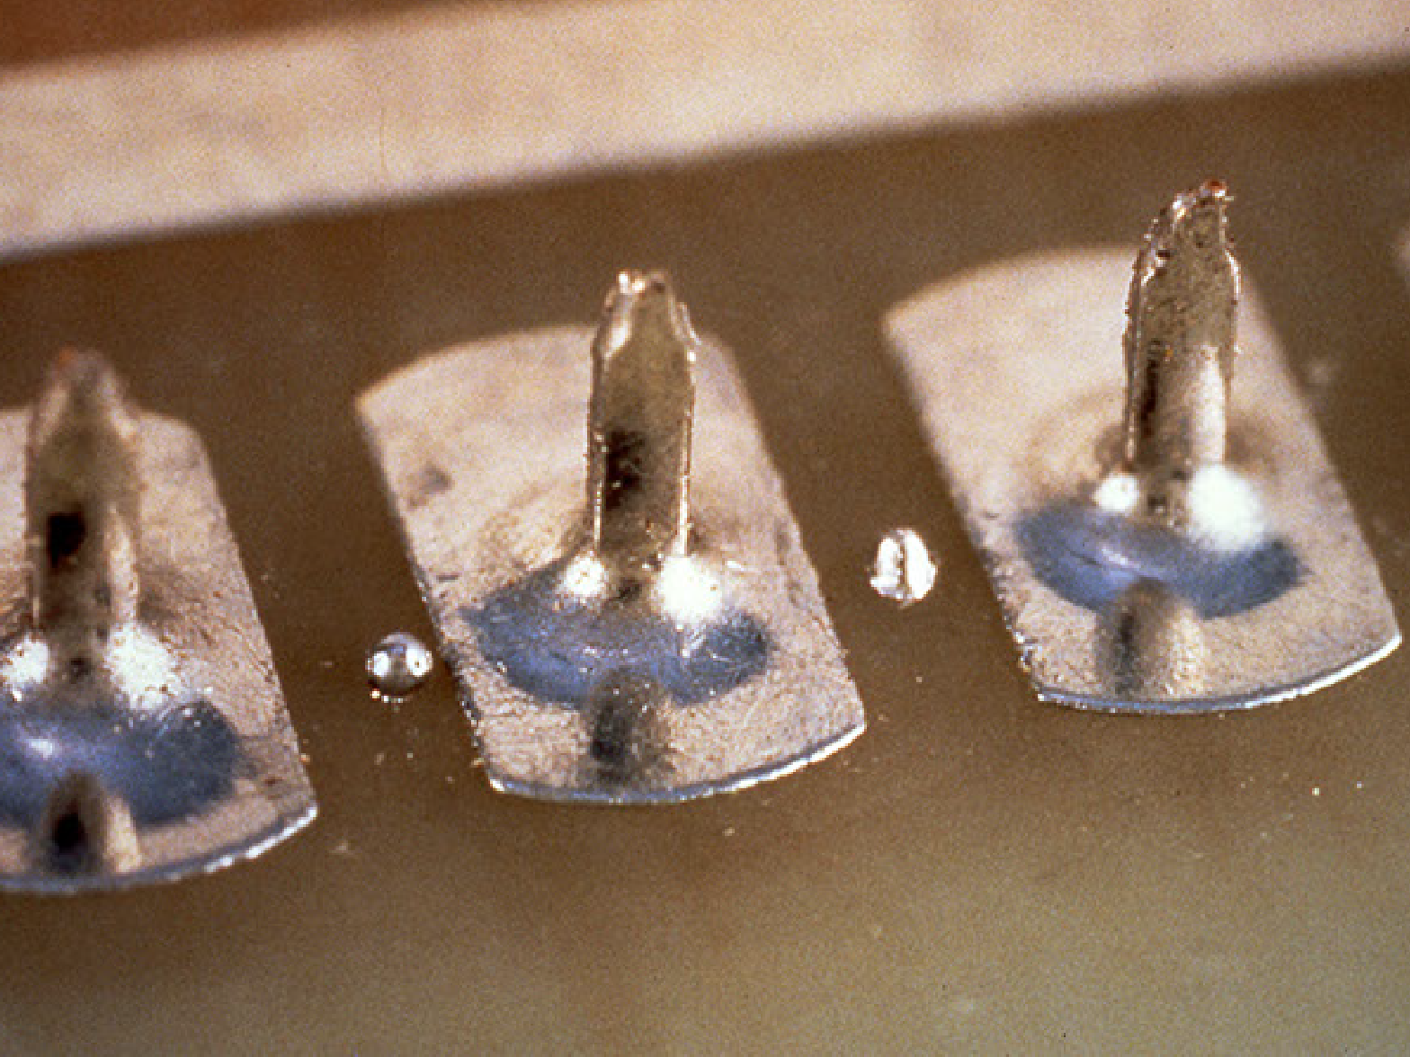
Solder splashes/splaaers/balls -­‐ Reject

Slide 51
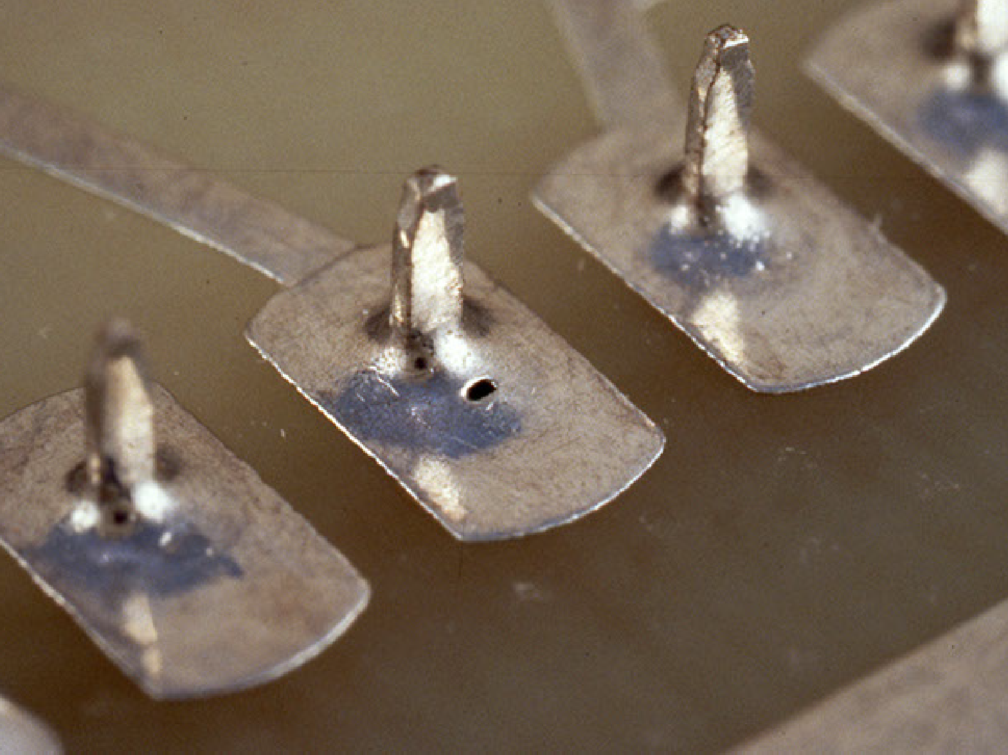
Pin hole -­‐ Reject

Slide 52
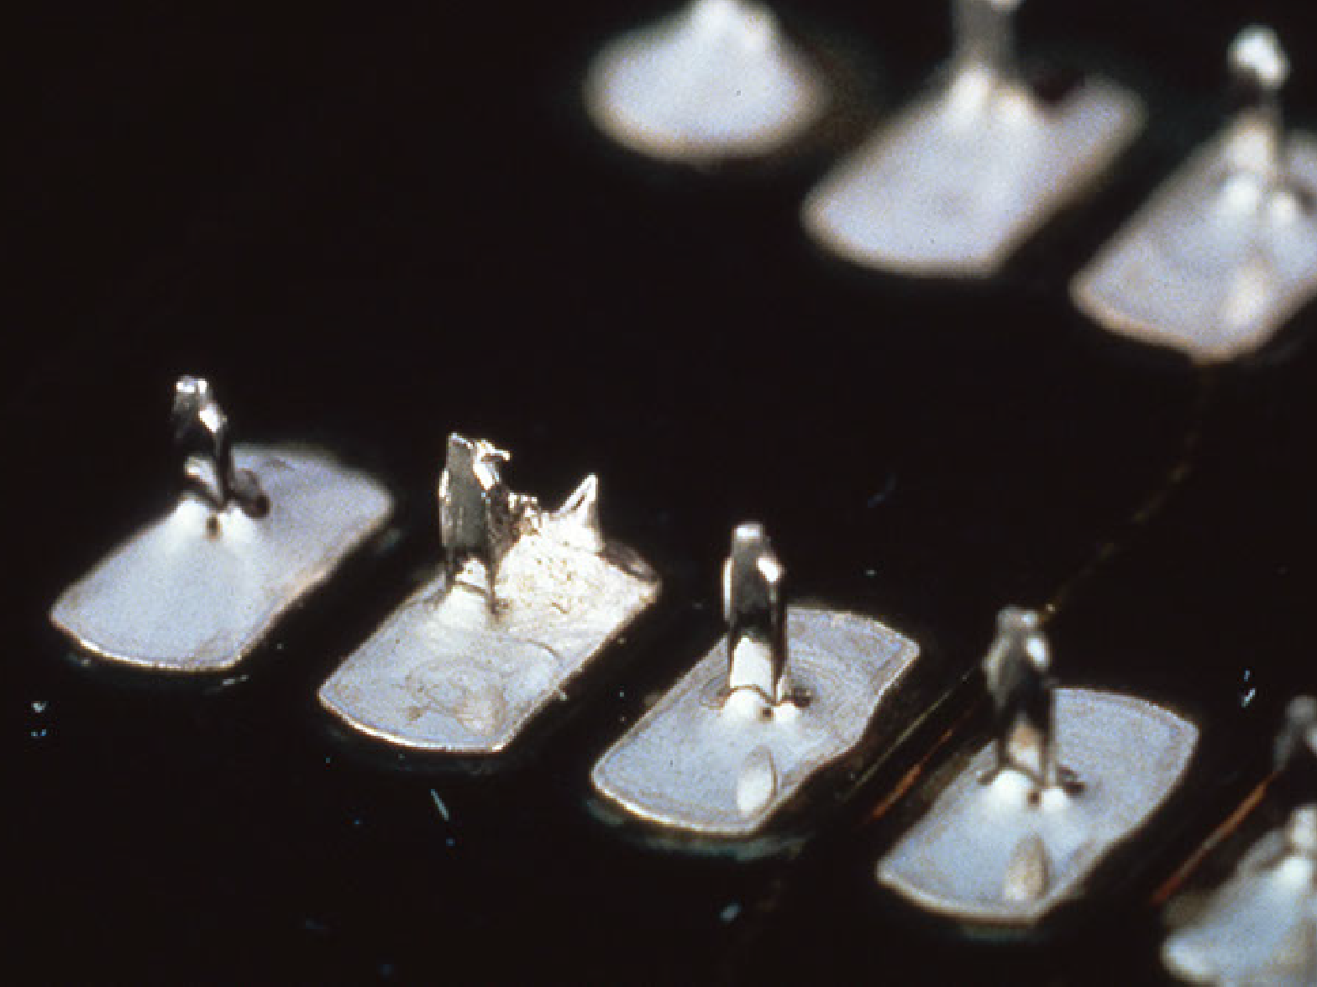
Solder spikes, peaks and icicles -­‐ Reject

Slide 53
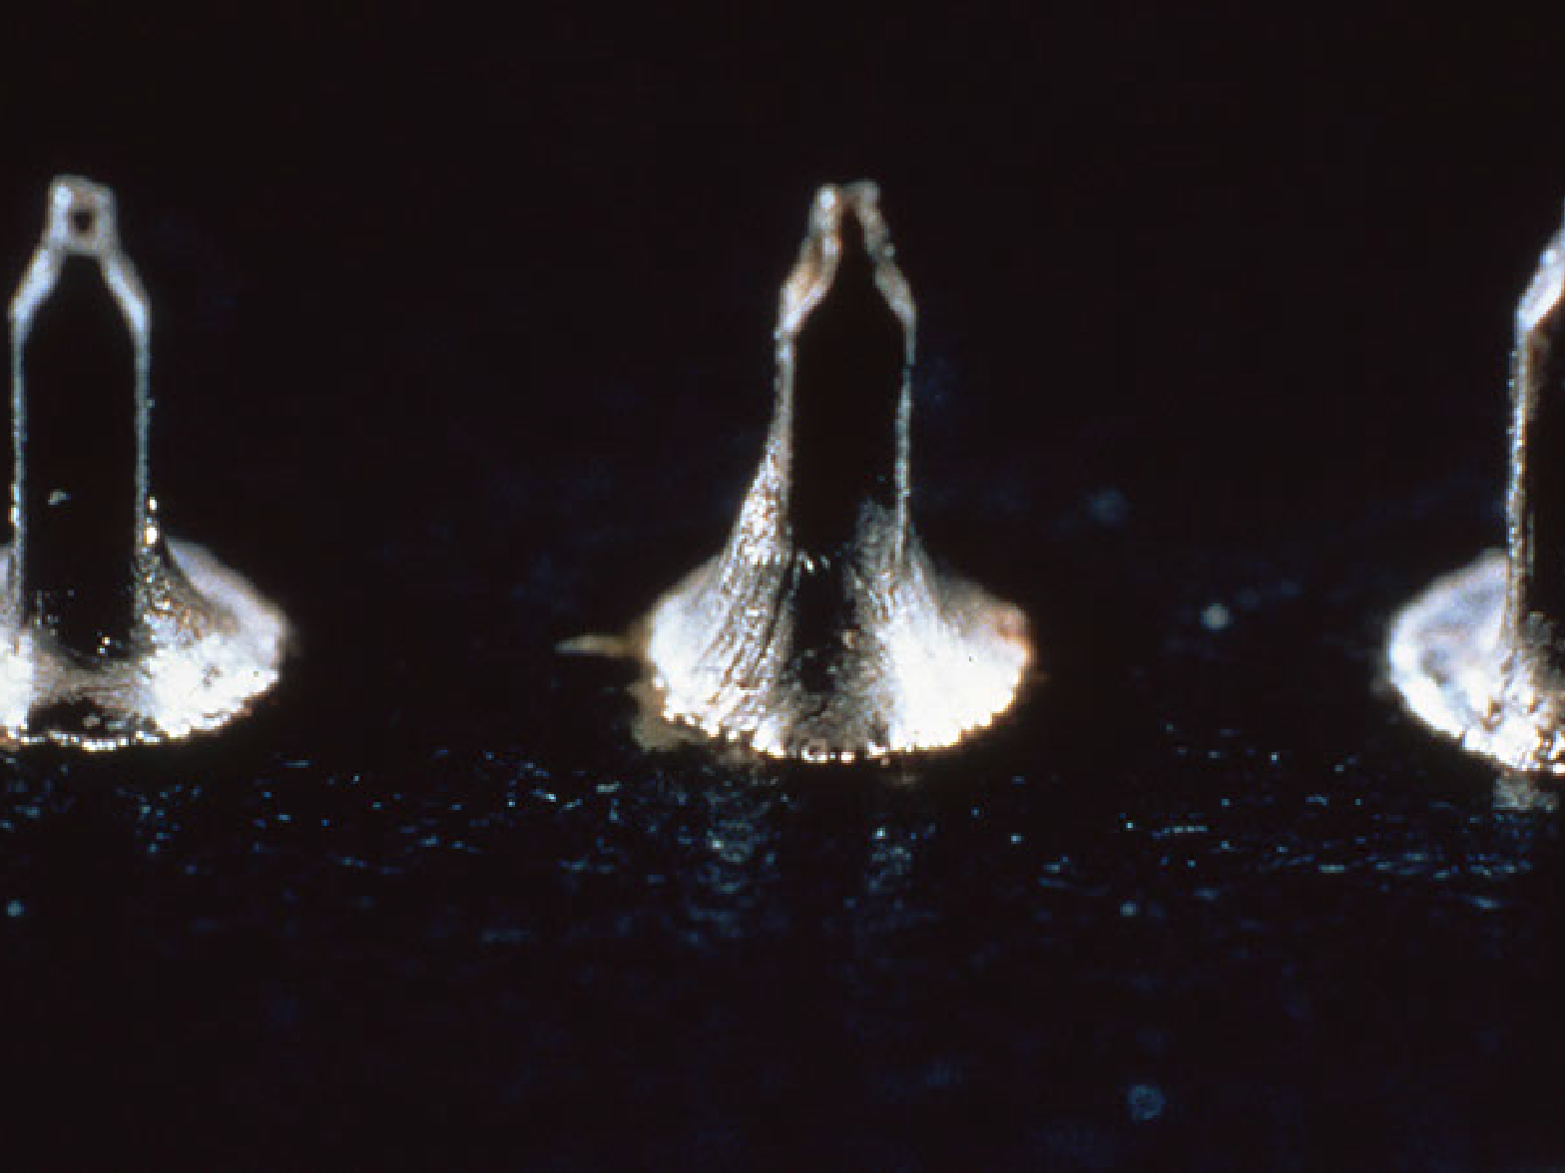
Stress lines -­‐ Reject

Slide 54


Slide 55


Slide 56
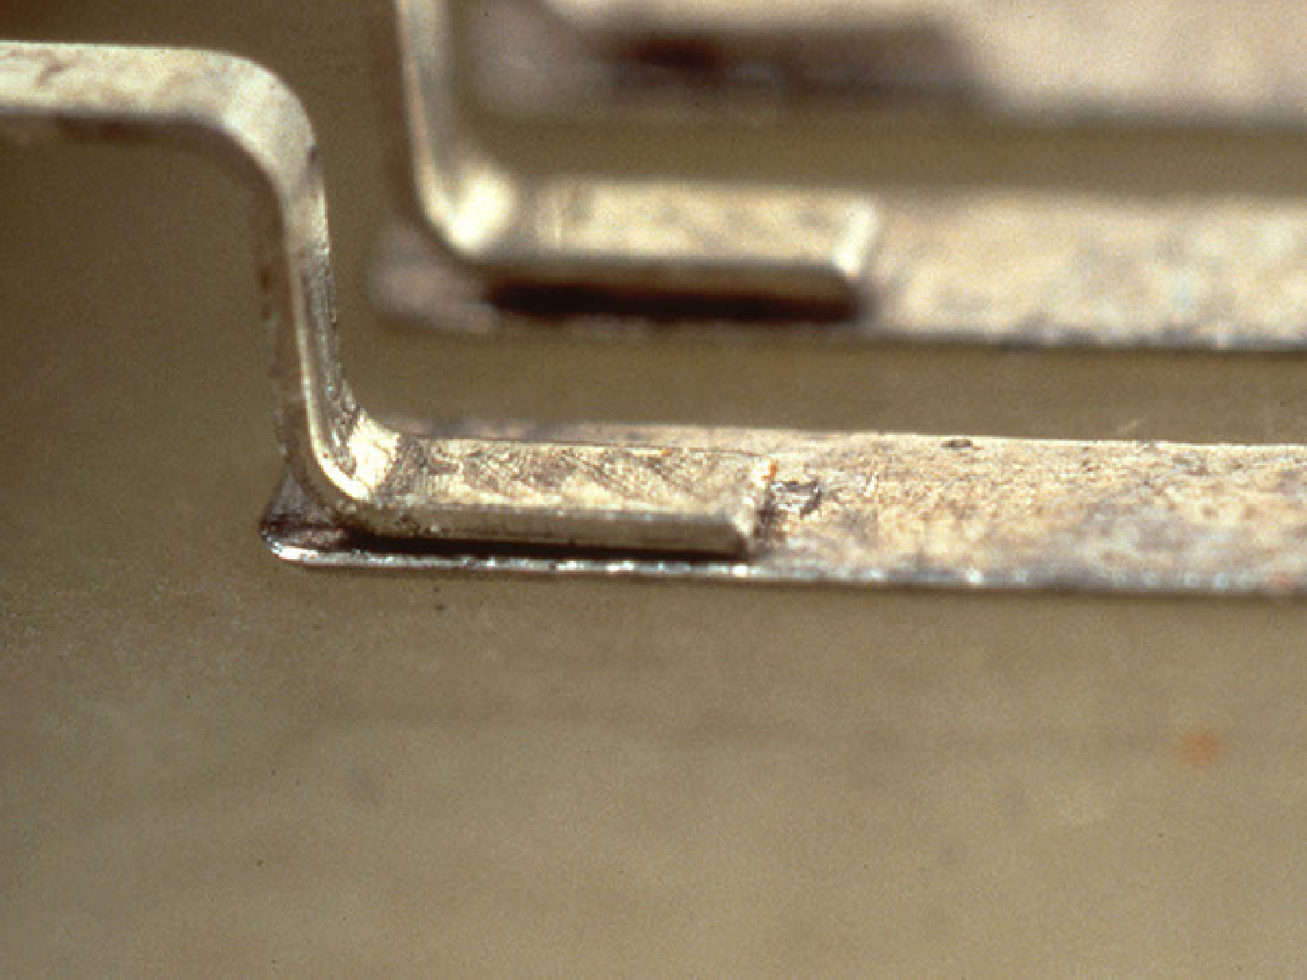
Preferred mounting -­‐ Accept

Slide 57
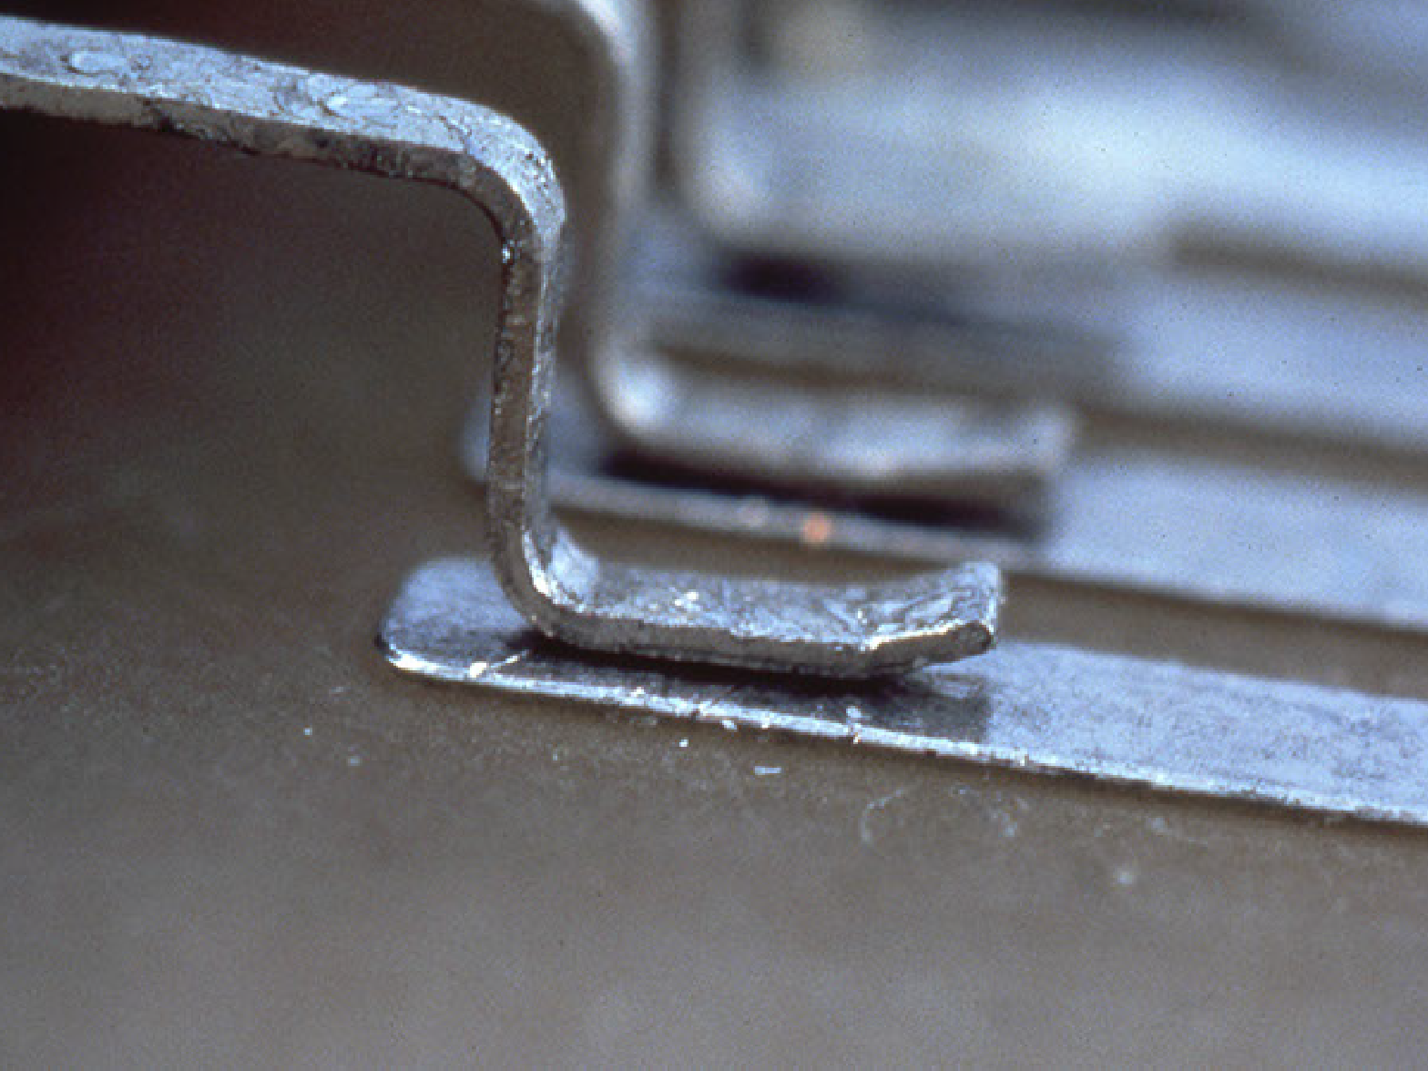
Toe up/curl -­‐ Reject

Slide 58
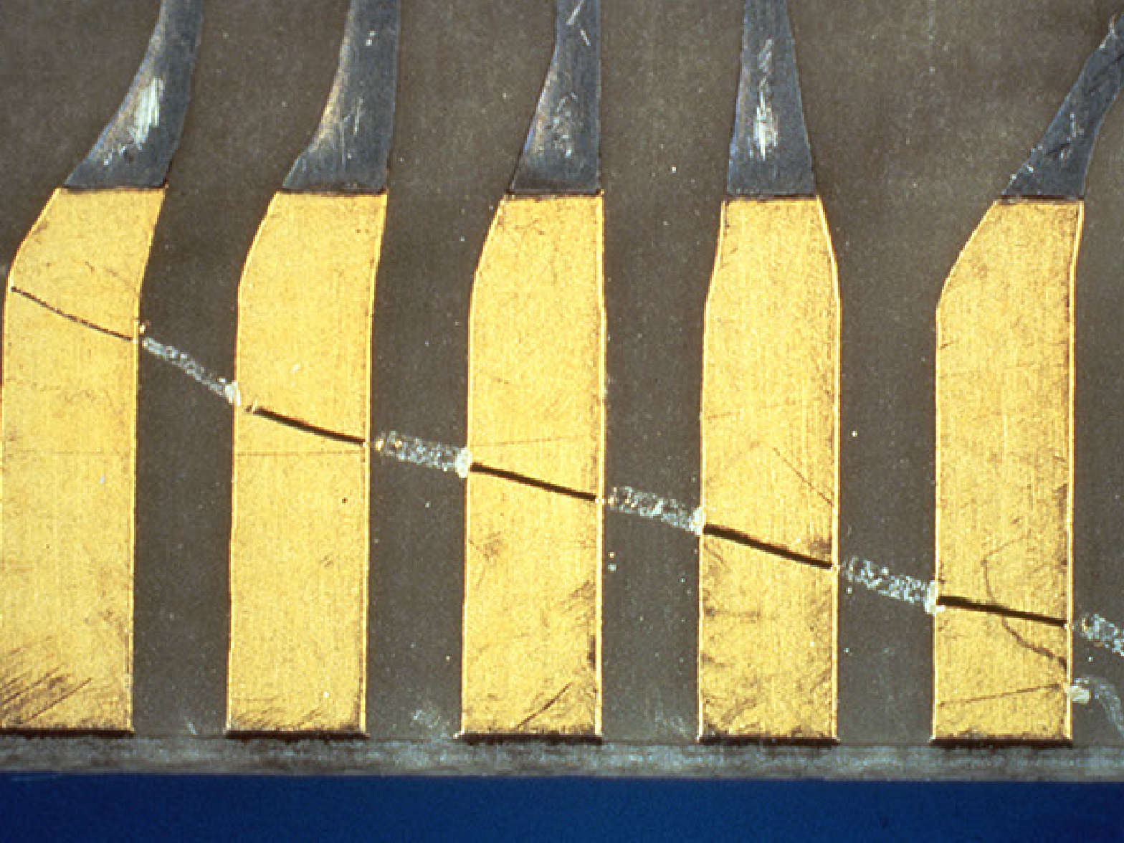
Scratches on pads -­‐ Reject

Slide 59
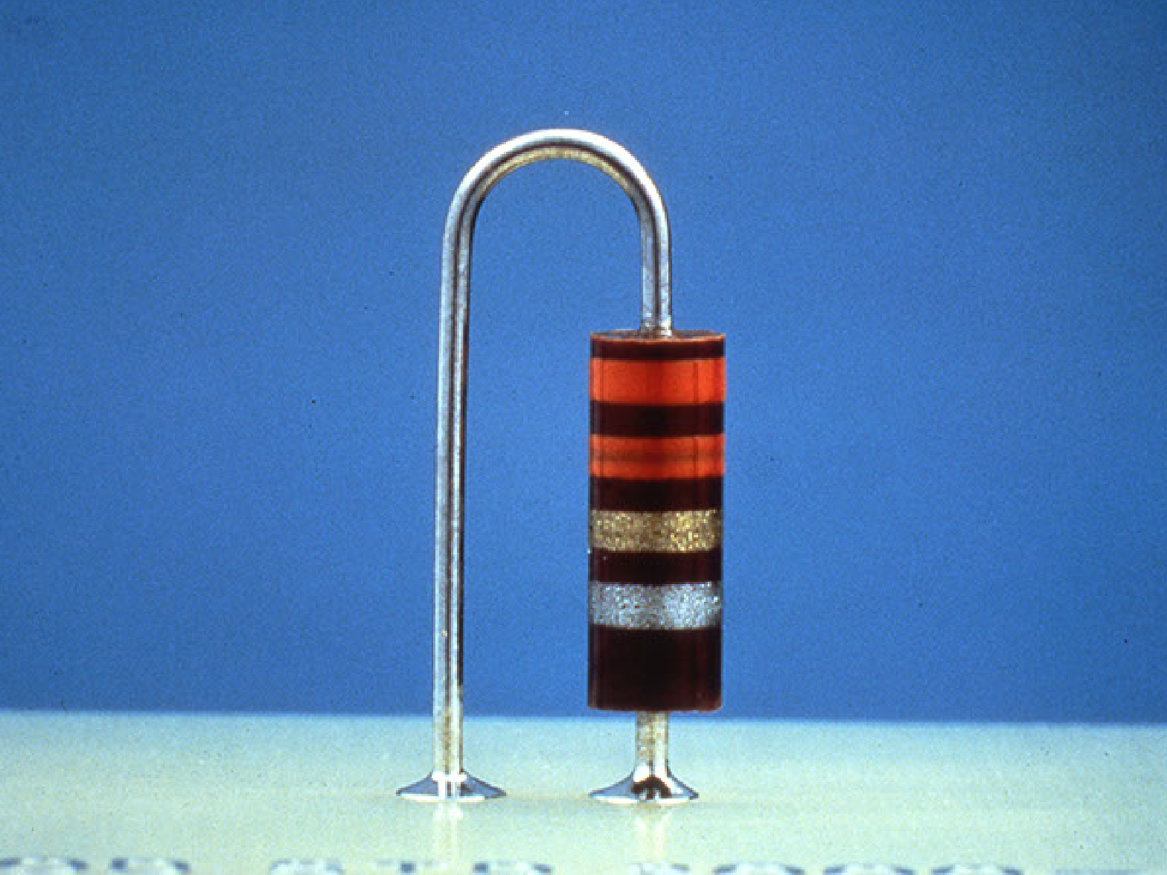
Vertical component mounting -­‐ Accept

